Slide 1
SECURING CONTAINERS WITH OPENSHIFT
<Name>
<Title>
<Date>

Slide 2

SECURITY MUST BE CONTINUOUS
And integrated throughout the IT lifecycle
Identify security requirements & governance models
DESIGN
Built-in from the start; not bolted-on
BUILD
Security policy, process & procedures
ADAPT
Deploy to trusted platforms with enhanced security capabilities
Revise, update, remediate as the landscape changes
RUN
MANAGE
Automate systems for security & compliance

Slide 3



COMPREHENSIVE CONTAINER SECURITY
Container Content
CI/CD Pipeline
CONTROL Application Security
Container Registry
Deployment Policies
Container Platform
Container Host Multi-tenancy
DEFEND Infrastructure
Network Isolation
Storage
Audit & Logging
API Management
EXTEND
Security Ecosystem
Notes:
Static security policies & checklists no longer suffice and don’t scale for containers in the enterprise. To truly get the business advantages of containers, enterprises need to evolve their approach to security. Security must become a continuous activity. And must be considered at every stage of your application and infrastructure lifecycle. Doing this right, with planning up front, can lead to better, more integrated security solutions and faster app delivery
Securing containers is a lot like securing any running process. You need to think about security throughout the layers of the solution stack before you deploy and run your container. You also need to think about security throughout the application and container life cycle. We’re going to look at securing containers in the 3 major categories of an enterprise container solution: You need to control the security of your containerized apps, defend your container platform infrastructure and extend the security of your overall solution by leveraging tools from the broader security ecosystem.

Slide 4
HARDENING TOOLS & APPLICABILITY GUIDES
Product Applicability Guides
FISMA Moderate & FISMA (NIST)
ISO 27001
PCI-DSS
PCI-DSS Reference Architecture
OpenShift Hardening Guide for 3.10 & 3.11 - OpenShift 4 Guide planned for Fall 2019
Upstream, 3rd party tools
docker-bench supports versions 1.13 and 17.06
kube-bench → WIP, support for OCP 3.9 & 3.10
https://orocktech.com/company/news/2019-07-23/
Notes:
OpenSCAP
3rd party tools are sponsored by Aqua Security.
docker-bench supports versions 1.13 and 17.06
kube-bench → WIP, support for OCP 3.9 & 3.10
Can be used to check for compliance against the CIS docker and kubernetes benchmark

Slide 5


CONTROL APPLICATION SECURITY

Slide 6



DEVSECOPS
THROUGH THE ADOPTION OF CONTAINERS
We created Dev and Ops and Security user stories and tackled them together.
I can break builds if security and compliance rules aren’t followed…
We’re empowering the developers and ideally empowering them straight to production.
DEVELOPER
SECURITY
OPERATIONS
DevNation Federal - The Journey to DevSecOps
Notes:
USCIS Spoke at Red Hat’s DevNation Federal in 2017 about their journey to DevSecOps with containers. (Internal Note: we can’t state that USCIS is an OpenShif customer as they are not a public reference. But their talk is available on YouTube.)
Adrian Monza, Branch Chief for Cyberdefense believes that deploying containers improves security. Adrian’s team worked with the head of Dev & Ops to integrate security into their container CI/CD pipeline. They’re now able to break a build if a new vulnerability is found during CI. Furthermore, the logging features built into the CI/CD pipeline ensure that they have a clear view of who changed what in every container build and deployment.
Steve Grunch, Manager, Cloud Service Platform
Adrian Monza, Branch Chief for Cyberdefense
Rob Brown, Branch Chief of Enterprise Business Services
AM “What really appealed to me about containers was the consistency. There are fewer things in my environment that I need to secure. I have one platform that we can deploy containers to.”
AM “We’re working with (eng & ops) to curate what images we make available to developers so we can give them things where most of the security work has already been done for them. It makes our lives that much easier. It gets us closer to security truly being a default.”
AM “It became one pipeline that I can integrate with. … I can break builds if certain security and compliance rules aren’t followed, if there are known vulnerabilities. That’s huge for me. … By the time something’s ready to go to production, the security checks have already been done.”
SG “Because security is actually integrated at the beginning with the development phases once we do bring the application into production we have a higher level of confidence that we do meet the security requirements, that we can maintain our authority to operate, and we have a higher confidence in its ability to be available for our customers.”
RB “One of the key factors for us was that we had senior leadership support.”
AM “Most of the people on my team (security) are not developers. We typically come out of an ops engineering focus … and we don’t really understand what is involved in doing the development, the nuts and bolts of bringing an application to production. One of the key differences is we started writing code for ourselves. We started adopting the tools that the developers were already using. By doing that it helped us understand where they were coming from and how things worked. We’re able to integrate better with them.”
RB “Culturally there’s been a real focus on developing relationships across the organization to facilitate these things.”
RB Creating “Dev and Ops and Security user stories and then tackling them”
AM “When you have consistent configurations, if I ever need to make a configuration change from a security perspective it’s much, much easier to apply that enterprise wide. The level of automation is absolutely huge. “
AM “No ssh in production. No one’s making manual changes. From a security perspective, that really limits the attack surface.”
RB “We’re empowering the developers and ideally empowering them straight to production.”
AM “Straight to production still makes me nervous.”
AM “I’m really excited about things like source to image. The idea that all the developer gets to bring is code… oh it doesn’t work with the hardening settings? Darn! Better rewrite the code.” “It’s a bunch of standardized lego bricks and as long as they play within the rules they can build these great things. … We’ve built security into all the primitives they’re going to use.”
“From a security perspective, we need to have better tooling and support for the pipelines. … On a regular basis, the developers are getting much more feedback about the security issues on the containers they’re using and in the code they’re working on pushing. “ “If I can move left that far, there’s no more of these manual processes where someone has to bring code to us and we do a manual review. That takes two weeks.”
RB “Creating that factory to abstract away a lot of those moving parts so there is reproducibility, traceability”
SG: “Implementing these CI/CD pipelines, these DevSecOps methodologies... is an organization wide activity.” “Consider onboarding all of your departments: HR, legal, contracting.”
AM “In terms of my best practices, throw away the GUIs, everything needs to be code, consistency is so important.”
AM “When you have everything expressed as code, it’s all consistent, it’s all in a single place…. Think about what that does from an auditability standpoint.”
“Education is crucial throughout this.”

Slide 7
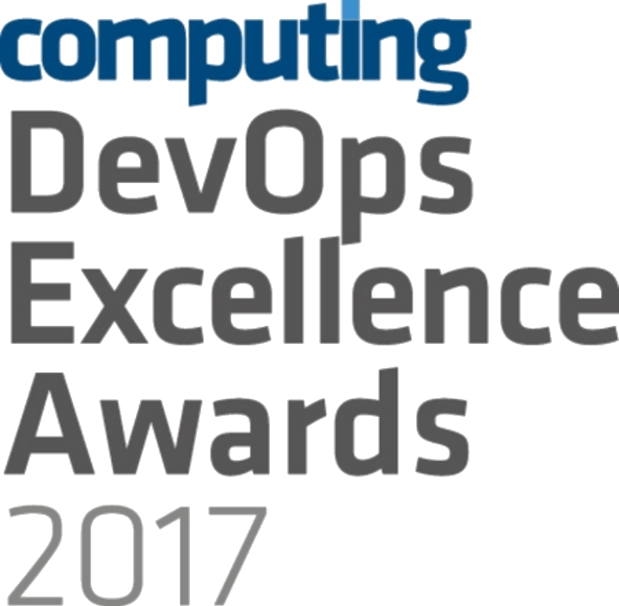



OPENSHIFT LOVES CI/CD
JENKINS-AS-A SERVICE
ON OPENSHIFT
HYBRID JENKINS INFRA WITH OPENSHIFT
EXISTING CI/CD DEPLOY TO OPENSHIFT
Notes:
OpenShift loves CI/CD and won the DevOps Excellence Awards 2017 in the Best Development Platform category http://events.computing.co.uk/devopsexcellence/static/2017-winners
OpenShift provides certified Jenkins container images as well as a number of Jenkins plugins to facilitate integrating Jenkins with OpenShift and building CI/CD Pipelines. Teams can decide how they want to use OpenShift for building CI/CD workflows considering their previous investments into their existing CI/CD infrastructure:
Jenkins-as-a-Service on OpenShift: run your Jenkins masters and slaves in OpenShift, by providing "Jenkins as a Service" on the platform.
Hybrid: Keep your Jenkins master infrastructure as it is, run Jenkins slaves in OpenShift containers for extra build capacity when you need it.
Keep Everything As-Is: Run your CI/CD infrastructure outside of OpenShift as-is and just use OpenShift as a deployment platform. Has the advantage of not disturbing what the customer already has in place and also allowing them to continue using alternate, non-Jenkins based CI and CD like Bamboo, TeamCity, Go CD, etc.

Slide 8





USE THE OPENSHIFT PIPELINE
ServiceNow
JIRA Service Desk Zendesk
BMC Remedy
DEVELOPER
GIT SERVER
ARTIFACT REPOSITORY
RELEASE MANAGER
GO LIVE?
OPENSHIFT
CI/CD PIPELINE
(JENKINS)
☒ ☑
IMAGE BUILD
& DEPLOY
PROMOTE
TO TEST
PROMOTE
TO UAT
PROMOTE
TO PROD
OPENSHIFT
IMAGE
REGISTRY
OPENSHIFT
IMAGE
REGISTRY
OPENSHIFT
CLUSTER
OPENSHIFT
CLUSTER
NON-PROD
DEV
TEST
UAT
PROD
Notes:
Talking points:
Deploy images, application binaries or source code with OpenShift
Your developers do not need to learn to build containers; with OpenShift Source2Image, developers can simply write code as they always do, and OpenShift will build the images

Slide 9




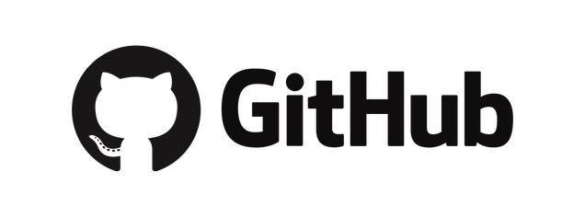

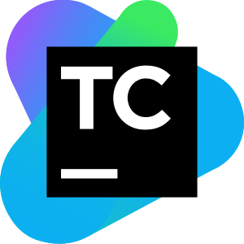

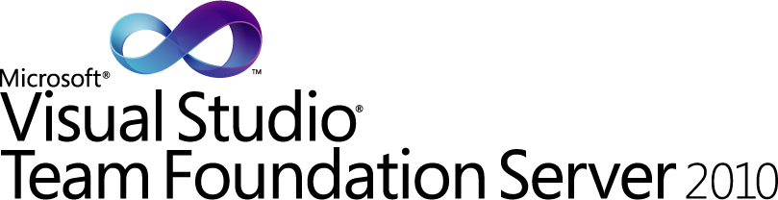



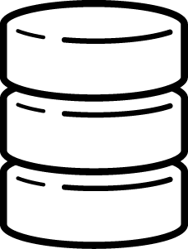



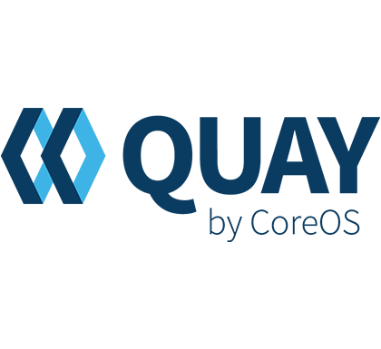
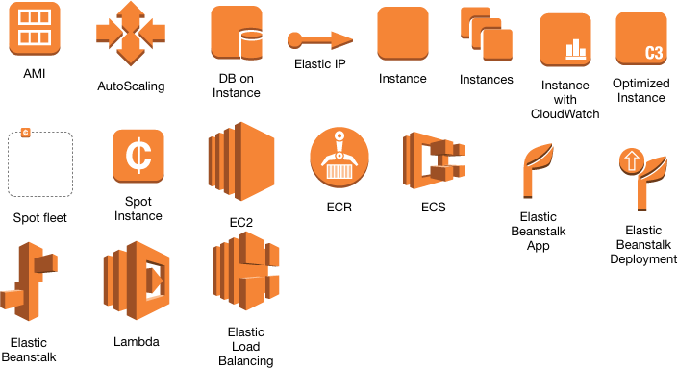
OR USE EXISTING DELIVERY PROCESSES
BUILD APP
BINARY
RUN
TESTS
PROMOTE APP
BINARY
BUILD CONTAINER IMAGE
RUN
TESTS
PROMOTE CONTAINER
IMAGE
SOURCE
VERSION
CONTROL
ENTERPRISE
BINARY REPO
ENTERPRISE
IMAGE REGISTRY
AWS ECR
Notes:
There are a variety of popular Git repository, CI/CD engines, application binary repositories and container image repositories already being used at teams and prospects often with lots of love and satisfaction
However what’s often lacking is the end-to-end automation till deployment into various environments. Sure even that is in-place at many prospects but at the cost of many home-grown and brittle scripts plumping various parts of the infrastructure together. Maintaining this delivery infrastructure is often costly and takes a sizeable time and effort (particularly from the best talents in the organization) away from building and deploying apps and into building and and deploying the delivery process for building and deploying apps!

Slide 10



DEPLOY IMAGES, APPLICATION BINARIES OR SOURCE CODE WITH OPENSHIFT
BUILD APP
(OpenShift)
code
Git Repository
Developer
BUILD IMAGE
(OpenShift)
Source-to-Image (S2I)
Builder Image
Image Registry
DEPLOY
(OpenShift)
Application Container
deploy
User/Tool Does
OpenShift Does

Slide 11

JENKINS-AS-A-SERVICE ON OPENSHIFT
Certified Jenkins images with pre-configured plugins
Provided out-of-the-box
Follows Jenkins 1.x and 2.x LTS versions
Jenkins S2I Builder for customizing the image
Install Plugins
Configure Jenkins
Configure Build Jobs
OpenShift plugins to integrate authentication with OpenShift and also CI/CD pipelines
Dynamically deploys Jenkins slave containers
Plugins Jobs
Configuration
Jenkins (S2I)
Jenkins Image
Custom Jenkins Image

Slide 12





SECURE & AUTOMATE THE CONTENT LIFECYCLE
Elements of the Openshift container pipeline
TRUSTED
CONTENT
UNKNOWN
CONTENT
Git
EXTERNAL IMAGES
PRIVATE REGISTRY
CI
CD
CONTENT METADATA
Notes:
Let’s take a look at the elements of the container lifecycle. From the left of the diagram is input to the system. Ideally, any external content you pull into your pipeline should be from trusted sources, but application libraries may be introduced from unknown sources as well. Proactive content management is key to a secure model.
Inspecting content metadata at the earliest stage provides a control point to validate content.
Building and promoting to a private registry provides an opportunity to assign policy to ensure the system is secure. This includes checking signatures, code scans and open source licensing checks.
Content metadata introspection at this stage provides a control point to validate ingested content.
Building and promoting to a private registry provides an opportunity to assign policy to ensure the system is secure. This includes checking signatures, code scans and open source licensing checks.

Slide 13
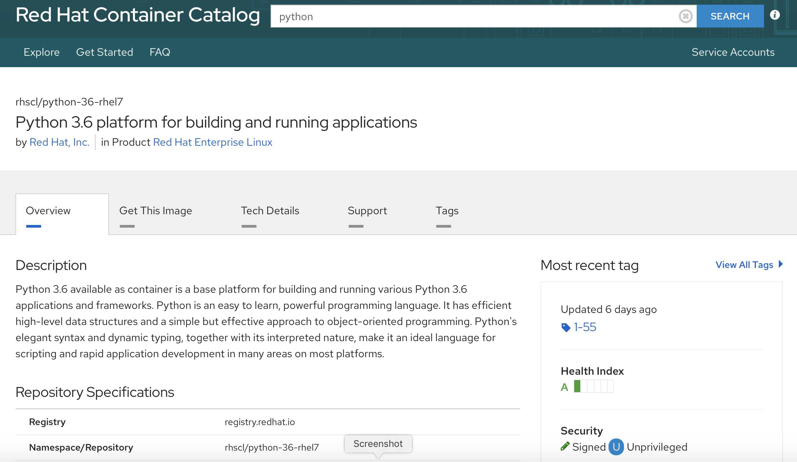
EXTERNAL CONTENT: USE TRUSTED SOURCES
Red Hat Container Images
Signed Images
Health Index (A to F grade)*
Security advisories & errata (patches)
*More about the Health Index
Notes:
We’ll start by talking about the external packages you use to build your applications. These days applications typically include open source components, such as the Linux operating system, Apache Web Server, JBoss Enterprise Application Platform, PostgreSQL, and Node.js. Containerized versions of these packages are readily available, so that you don’t have to build your own.
Red Hat provides a large number of certified images, including RHEL base images as well as various language runtimes, middleware, databases and more via the Red Hat Container Catalog. Red Hat certified containers run anywhere Red Hat Enterprise Linux runs, from bare metal to VMs to cloud. Certified containers are supported by Red Hat and our partners. Container image content is packaged from known source code. And Red Hat also provides security monitoring.
The Red Hat Container Catalog includes the Container Health Index. Red Hat exposes the “grade” of each container image. Containers are graded based in part on the age and impact of unapplied security errata to all components of a container, providing an aggregate rating of just how safe a container is that can be understood by security experts and non-experts alike.
When Red Hat releases security updates–such as fixes to glibc, Drown, or Dirty Cow–we also rebuild our container images and push them to our public registry. Red Hat Security Advisories alert you to any newly discovered issues in certified container images and direct you to the updated image so that you can, in turn, update any applications that use the image.

Slide 14
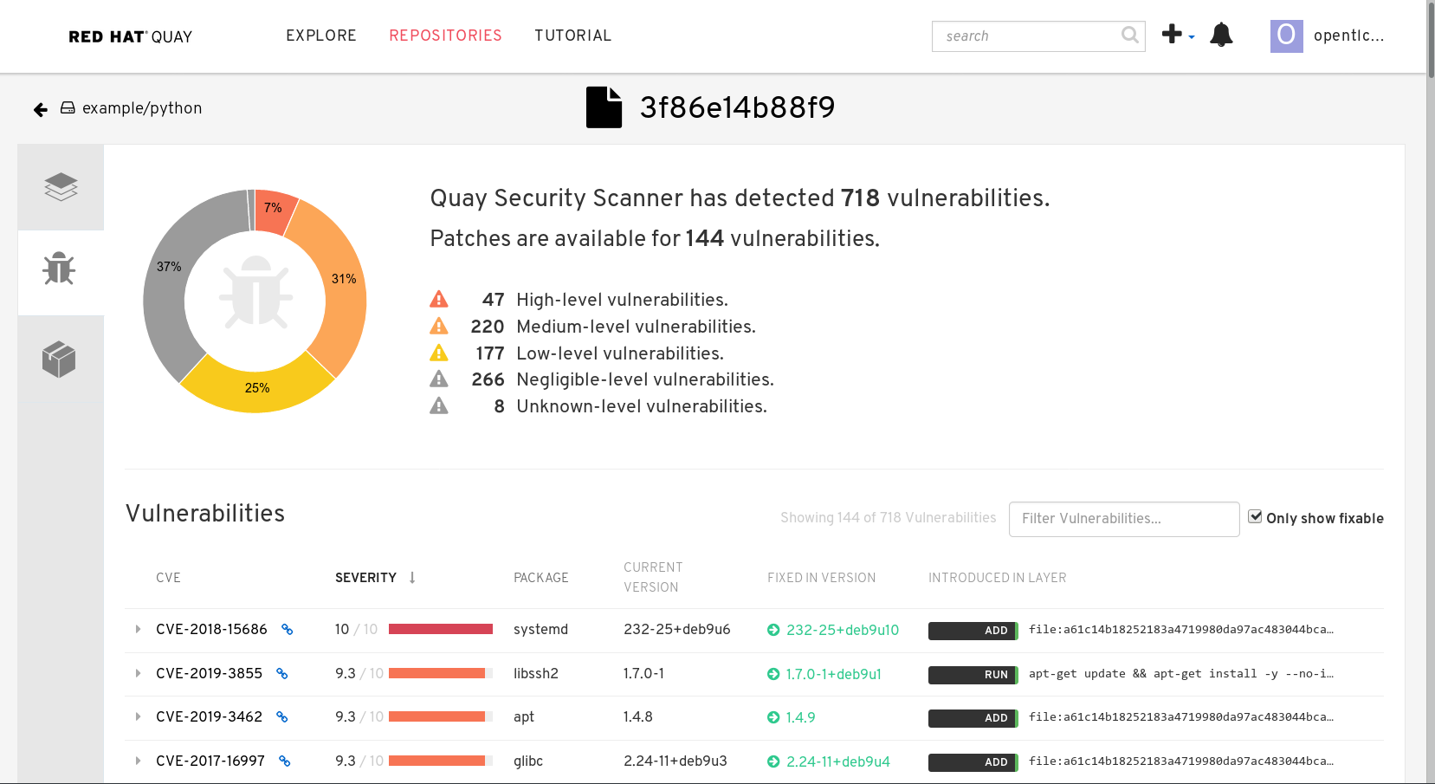
RED HAT QUAY
ENTERPRISE CONTAINER REGISTRY
Offered as self-managed and as-a-service
Vulnerability Scanning (Clair)
Geographic Replication
Build Image Triggers
Image Rollback with Time Machine

Slide 15
CI/CD MUST INCLUDE SECURITY GATES
OPENSHIFT
CI/CD PIPELINE
(JENKINS)
Integrate security testing into your build / CI process
Use automated policies to flag builds with issues
Sign your custom container images
☒ ☑
IMAGE BUILD
& DEPLOY
PROMOTE
TO TEST
PROMOTE
TO UAT
PROMOTE
TO PROD
UNIT
TEST
CODE
QUAL
VULN SCAN
INT
TEST
QA
UAT
-Cucumber
-Arquillian
-Junit
-Sonarqube
-Fortify
-App Scan
-Aqua Security
-Black Duck
-Clair
-Sonatype
-Twistlock
Notes:
As with any application, managing your production builds is a key part of securing your software stack. A definitive build environment is important for production container deployment. You don’t want developers doing “docker build” on their laptops and then deploying that build to production. OpenShift includes the Source-to-Image build feature, making it easy for your development and ops teams to collaborate on a reproducible build environment. OpenShift also supports the use of Jenkins for continuous integration (CI) or you can integrate your own CI environment with OpenShift if you prefer. Once a build is complete, the image should be pushed to your private registry. This is done automatically when you use OpenShift’s source-to-image functionality. Many companies choose to add signatures to their images as a further security check. Signatures must be verified before an image is deployed to production. This process needs to be scripted today, but we’re working to integrate signing into the OpenShift container lifecycle.
Knowing that new vulnerabilities are identified daily, you need to proactively check container contents over time. One of the best ways to do this is to integrate automated security testing into your build / CI process. For example, you should run component analysis tools tools that provide real-time updates on known vulnerabilities, like Black Duck Hub or JFrog Xray as part of your CI process. And your CI process should include policies that flag builds with issues discovered by security scans so that your team can take appropriate action.
Integrate security tools & policies into CI/CD
Automatic scans with default actions
Deploy within security context constraints
Validation
Check Signatures
Identify/track known issues
Code scans
Licensing
Manual approval when needed
Sign-off
Publication scope

Slide 16
MANAGING CONTAINER DEPLOYMENT
Deployments: Containerized App Configuration as Code
Whitelist / Blacklist external repos
Apply runtime security policies
Validate image signatures
Monitor for new vulnerabilities
Trust is temporal: rebuild & redeploy as needed
DEVELOPER
GIT SERVER
ARTIFACT REPOSITORY
RELEASE MANAGER
ServiceNow
JIRA Service Desk Zendesk
BMC Remedy
GO LIVE?
OPENSHIFT
CI/CD PIPELINE
(JENKINS)
☒ ☑
IMAGE BUILD
& DEPLOY
PROMOTE
TO TEST
PROMOTE
TO UAT
PROMOTE
TO PROD
INTEGRATED
IMAGE
REGISTRY
INTEGRATED
IMAGE
REGISTRY
OPENSHIFT
CLUSTER
OPENSHIFT
CLUSTER
NON-PROD
DEV
TEST
UAT
PROD
Notes:
In case anything falls through during the build process or for situations where a vulnerability is discovered after an image has been deployed, you want yet another layer of security: tooling for automated, policy-based deployment. This is particularly important as best practice is not to patch running containers, but instead, use triggers to rebuild and replace with automated updates. You can choose how much of this process you automate -- but a key point here is that you never patch a running container -- always fix the issue at the source, rebuild your container image and redeploy. No more ssh into production environments.
For example, let’s look at an application that’s built using 3 container image layers: core, middleware, and finally, the application layer. If an issue is discovered in the core image, that image is rebuilt. Once the build is complete, the image is pushed to OpenShift’s Atomic registry. OpenShift can detect that the image has changed. For builds that are dependent on this image, and that have triggers defined, OpenShift will automatically rebuild the application image, incorporating the fixed libraries. Triggers can also be used to automate deploying the updated images.
OpenShift’s Security Context Constraints (or SCCs) allow an administrator to control the running of privileged containers, the capabilities a container can request to be added, the use of host directories as volumes, the SE Linuxin context of the container, the creation of seccomp profiles and the container user id.

Slide 17
SECURE & AUTOMATE THE CONTENT LIFECYCLE
Trust is temporal; rebuild and redeploy as needed
TRUSTED
CONTENT
UNKNOWN
CONTENT
Git
EXTERNAL IMAGES
PRIVATE REGISTRY
CI
CD
Track updates & simplify management with ImageStreams
Use Image Change Triggers to automatically rebuild custom images with updated (patched) external images
CONTENT METADATA
IMAGESTREAM EVENTS
Notes:
OpenShift is a platform for automating application lifecycle. Security is integrated into this pipeline as a continual process.
This automation is driven by imagestream events. Imagestreams represent the content moving through the system. It provides automated lifecycle hooks to drive continuous integration and deployment, cycling back to the ingest point when issues are identified. Automated and manual approval workflows can be developed to serve the requirements of different environments or lifecycle stages.
ImageStream events help monitor changes to any external images you have stored in your repository Imagestreams represent the content moving through the system. It provides automated lifecycle hooks to drive continuous integration and deployment, cycling back to the ingest point when issues are identified. Automated and manual approval workflows can be developed to serve the requirements of different environments or lifecycle stages.
For example, OpenShift and the Jenkins integration provides automation hooks to automate pulling down new versions of images you use and kicking off new builds to incorporate those images.
Ultimately, by leveraging CI/CD and OpenShift, the entire process of rebuilding the application to incorporate the latest fixes, testing, and ensuring that it is deployed everywhere within the environment can be 100% automated.
---

Slide 18
DEFEND INFRASTRUCTURE

Slide 19
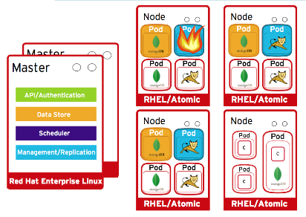
SECURING THE CONTAINER PLATFORM
Security Features Include
Host & Runtime security
Identity and Access Management
Role-based Access Controls
Project namespaces
Integrated SDN - Network Policies is default
Integrated & extensible secrets management
Logging, Monitoring, Metrics
RHEL CoreOS
RHEL
RHEL CoreOS
RHEL CoreOS
RHEL
Notes:
NOTE: encryption of data stored in etcd is not supported in 4.1. We’re working to add that feature back in 4.2
You also need to secure the container platform itself -- the orchestration tool you use to manage deploying container instances at scale. You use the orchestration layer, the control plane to
Determine which containers should be deployed to which hosts
manage shared resources like network and storage
Enable containers to discover each other and prevent containers from discovering each other
Automatically scale application capacity to meet demand
The orchestration masters are a central point of access and should receive the highest level of security scrutiny.
The OpenShift master includes a built-in role-based access controls which can integrate with the identity provider of your choice.
Multi-tenancy security is a must for the platform itself to enable developer self-service and make sure teams do not access each other’s environments without authorization. You need a self-service portal that gives enough control to teams to foster collaboration while still providing security. OpenShift adds several components to Kubernetes to ensure a secure multi-tenant master:
All access to the master is over TLS
Access to the API Server is X.509 certificate or token based
Project quota is used to limit how much damage a rogue token could do
Etcd is not exposed directly to the cluster

Slide 20




HOST OS CONTAINER MULTI-TENANCY
Container Security starts with Linux Security
CONTAINER
CONTAINER
Security in the RHEL host applies to the container
SELINUX and Kernel Namespaces are the one-two punch no one can beat
Protects not only the host, but containers from each other
RHEL CoreOS provides minimized attack surface
Common Criteria certification
APP
APP
LINUX O/S
DEPENDENCY
SELINUX
LINUX O/S
DEPENDENCY
SECCOMP
NAMESPACES
CGROUPS
Identity
AUDIT/LOGS
SVIRT
KUBERNETES KUBELET
LINUX CONTAINER HOST (KERNEL)
Notes:
As you look deeper, you will find that Container Security is built on Linux security!
Because containers start with Linux, OpenShift inherit RHEL’s industry leading container security practices and reputation.
Securing enterprise use of containers requires an OS that can manage multi-tenancy of the container runtime: you need an OS that can secure containers at the boundaries: securing the host kernel from container escapes and securing containers from each other.
There are multiple levels of security and a lot of history involved in securing containers on Linux. SELinux, Linux namespaces, CGroups, Capabilities and Read Only Mounts are five of the security features available for securing containers running on Red Hat Enterprise Linux.
You can further enhance security for your applications and infrastructure by deploying your containers to Red Hat Enterprise Linux Atomic Host. Atomic Host reduces the attack surface by minimizing the host environment and tuning it for containers.
As a proof point of the security features available to you with Red Hat Enterprise Linux and Atomic Host, RHEL 7.1 recently received Common Criteria certification, including certification of the Linux Container Framework Support.
Common Criteria cert for RHEL 8 is targeted for Nov 2019
RHEL COS does not yet support NBDE

Slide 21
Container Host Vision
An Ideal Container Host would be | RHEL CoreOS
Minimal | Only what’s needed to run containers
Secure | Read-only & locked down
Immutable | Immutable image-based deployments & updates
Always up-to-date | OS updates are automated and transparent
Updates never break my apps | Isolates all applications as containers
Updates never break my cluster | OS components are compatible with the cluster
Supported on my infra of choice | Inherits majority of the RHEL ecosystem
Simple to configure | Installer generated configuration
Effortless to manage | Managed by Kubernetes Operators

Slide 22




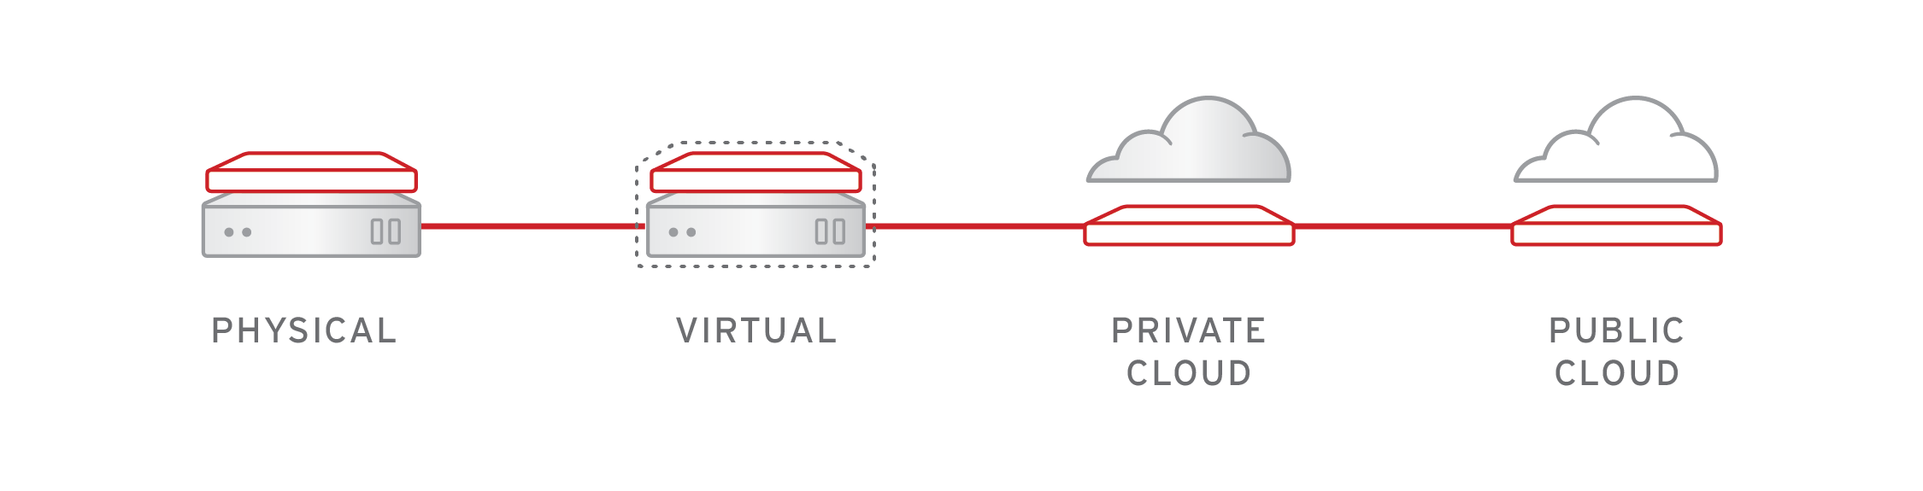
IMMUTABLE OPERATING SYSTEM
OPENSHIFT 4
Red Hat Enterprise Linux CoreOS is versioned with OpenShift
CoreOS is tested and shipped in conjunction with the platform. Red Hat runs thousands of tests against these configurations.
Red Hat Enterprise Linux CoreOS is managed by the cluster
The Operating system is operated as part of the cluster, with the config for components managed by Machine Config Operator:
CRI-O config
Kubelet config
Authorized registries
SSH config
OPENSHIFT PLATFORM
OPERATING SYSTEM

Slide 23




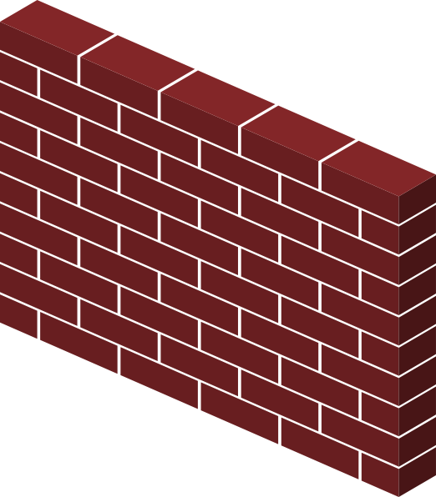





Air-gapped Environments
Disconnected Installation & Updating
# mirror update image: $ oc adm release mirror --from=<rht repo:version> \ --to=<local repo:version>
# provide cluster with update image to update to:
$ oc adm upgrade --to-mirror=<local repo:version>
Customer Cluster
Local Copy of Update Image
Red Hat sourced Update Image
Air-gapped OpenShift Cluster
Local Container Registry
Container Registry
Cluster updated locally
Mirrored to local registry
Admin
Support for installing and updating of OpenShift clusters in air-gapped environments is targeted for 4.2
Admins first need to mirror installation and update payload images to a local container registry, then openshift-install and ‘oc adm upgrade’ can be configured to leverage the offline content
RH CoreOS images for AWS will also need to be copied to a local S3 bucket and AMI ID defined in install-config
Notes:
For air-gapped clusters that can’t be connected back to Red Hat infrastructure, we’re planning to support disconnected installation and updating. While this won’t be part of the 4.1 release, we’re trying to target 4.2. It’s worth mentioning that the final design is still under discussion and subject to change from what is shown here.
To accomplish this, administrators will first need to mirror installation or update payload images to a local container registry with connectivity before applying. For installs, it will also require the mirroring RH CoreOS images and configuring the installer to use those images.
While the entire process is still not functionally complete, architecturally OpenShift 4 has been designed to support deployment in air-gapped environments and some of the mechanisms are even there now.

Slide 24

A lightweight, OCI-compliant container runtime
Optimized for Kubernetes
Any OCI-compliant container from any OCI registry (including docker)
Improve Security and Performance at scale
CRI - the Container Runtime Interface
OpenShift 4 defaults to CRI-O
Red Hat contributes CRI-O to the Cloud Native Computing Foundation
Notes:
Pids cgroups controls & SELinux support
Optional for 3.10 / Becomes the default runtime for nodes in 3.11
Adding user namespace support (target 3.11)
Continue to track and release with upstream Kubernetes
Kubernetes introduced Container Runtime Interface (CRI), a plugin interface that gives Kubernetes the ability to use different OCI-compliant container runtimes. Building on that work, the CRI-O provides a lightweight runtime for Kubernetes. Prior to the introduction of CRI, Kubernetes was tied to specific container runtimes while with CRI, Kubernetes can be container runtime-agnostic.
CRI-O currently supports the runc and Clear Container runtimes which are the more mature OCI-complaint runtimes

Slide 25
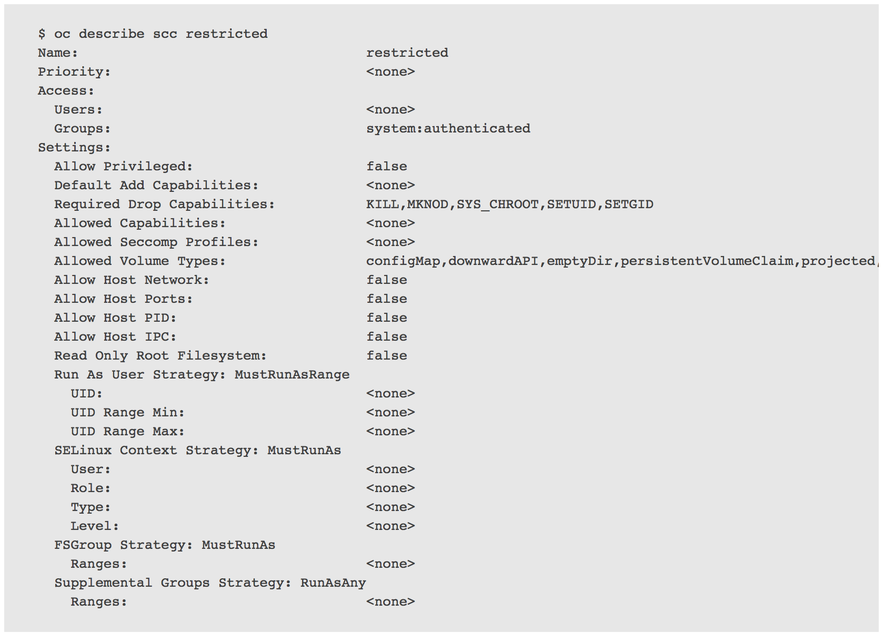
RUNTIME SECURITY POLICIES
SCC (Security Context Constraints)
Allow administrators to control permissions for pods
Restricted SCC is granted to all users
By default, no containers can run as root
Admin can grant access to privileged SCC
Custom SCCs can be created
Notes:
Seven SCCs are added to the cluster by default, including privileged and restricted. They allow an administrator to control the following:
Running of privileged containers; a key security concept is that processes should be run with the least possible privilege -- this is true for containers as well. You don’t want your containers to run as root unless absolutely necessary.
Capabilities a container can request to be added.
Use of host directories as volumes.
The SELinux context of the container.
The user ID.
A security context constraint is used to achieve the following goals:
Ensure a clear isolation between container and the underlying host it runs on
Limit the ability of the container to negatively impact the infrastructure or other containers

Slide 26
IDENTITY AND ACCESS MANAGEMENT
OpenShift includes an OAuth server, which does three things:
Identifies the person requesting a token, using a configured identity provider
Determines a mapping from that identity to an OpenShift user
Issues an OAuth access token which authenticates that user to the API
Supported Identity Providers include
Keystone
LDAP
GitHub
GitLab
GitHub Enterprise (new with 3.11)
Google
OpenID Connect
Security Support Provider Interface (SSPI) to support SSO flows on Windows (Kerberos)
Managing Users and Groups in OpenShift
Configuring Identity Providers
Notes:
Determines a mapping from that identity to an OpenShift user
Allows multiple identities to map to the same OpenShift user
Allows deconflicting between identity provider roles

Slide 27

PROJECTS ISOLATE APPLICATIONS across teams, groups and departments
PAYMENT DEV
CATALOG
POD
POD
POD
❌
POD
POD
POD
C
C
C
C
C
C
PAYMENT PROD
INVENTORY
POD
POD
POD
❌
❌
POD
POD
POD
C
C
C
C
C
C
Notes:
A user can only access projects that they have created or explicitly given access to

Slide 28
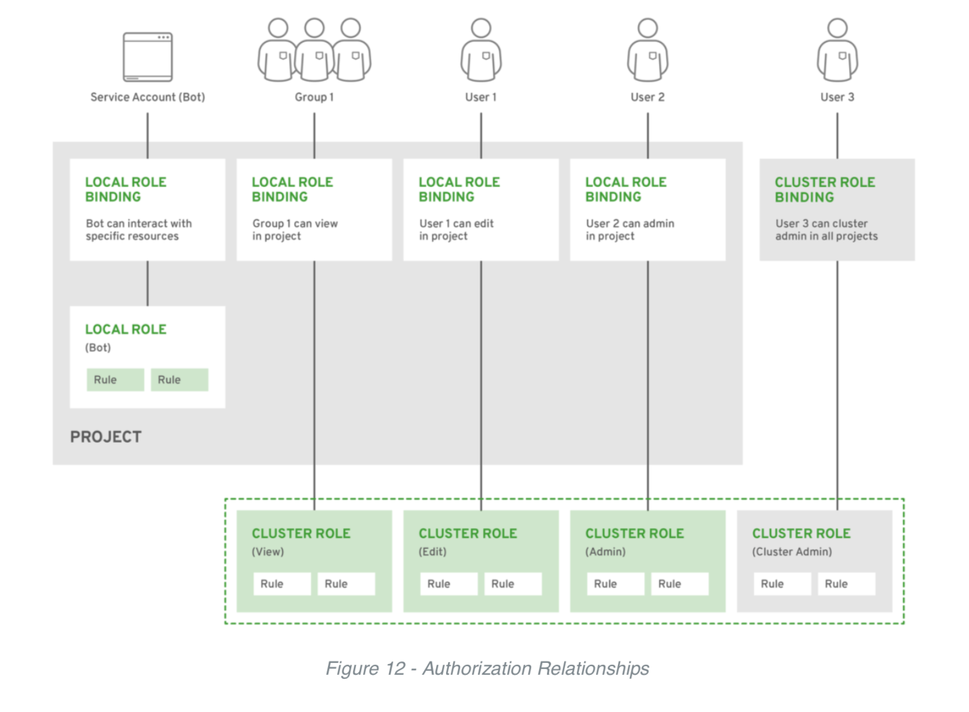
RESTRICT ACCESS BY NEED TO KNOW
Role based authorization
Project scope & cluster scope available
Matches request attributes (verb,object,etc)
If no roles match, request is denied ( deny by default )
Operator- and user-level roles are defined by default
Custom roles are supported
For more information see: Managing RBAC in OpenShift
Notes:
In OpenShift we have a role based authorization component. There is a Project scope and a Cluster scope where either RoleBindings or ClusterRolebindings define the permissions a user will have once logged in. This role component matches attributes on the request like the verb on the objects for example get projects or create pods. It matches those attributes to roles which have been grated to the requesting user. If no roles match the request is denied.By default everything is denied unless the role specifically allows it. Out of the box operator and user level roles are defined and custom roles are also supported.
Coalfire is a
Payment Card Industry Qualified Security Assessor (QSA)

Slide 29


OPENSHIFT NETWORKING
Built-in internal DNS to reach services by name
Software Defined Networking (SDN) for a unified cluster network to enable pod-to-pod communication
OpenShift follows the Kubernetes Container Networking Interface (CNI) plug-in model
Isolate applications from other applications within a cluster
Isolate environments (Dev / Test / Prod) from other environments within a cluster
Notes:
Check on DNS running in every node, not just master -- what’s the best wording?
OpenShift SDN can be configured to use Flannel instead of Open vSwitch. This is useful if running OpenShift Container Platform within a cloud provider platform that also relies on SDN, such as OpenStack, and you want to avoid encapsulating packets twice through both platforms.
OpenShift supports NuageSDN plugin up to and including the CNI plugin. NuageSDN itself is supported by Nuage.
When working with containers at scale, you need to consider network defense. OpenShift uses software defined networking (SDN) to provide a unified cluster network that enables communication between containers across the OpenShift cluster.
The first line in network defense comes from network namespaces. With network namespaces, each collection of containers (each pod) gets its own entire IP and port range to bind to, thereby isolating pod networks from each other on the node.
OpenShift also provides the ability to control egress traffic using either a router or firewall methods so that you can, for example, use IP whitelisting for database access.
In addition the OpenShift SDN provides additional security by offering isolation between master (orchestration) namespaces with the multi-tenant plugin. This means that packets from one namespace, by default, will not be visible to other namespaces: pods from different namespaces cannot send packets to or receive packets from pods and services of a different namespace. You can use these features to isolate the developer, test and production networks.
Network policies is the default for OpenShift 4. Network Policies provide more fine-grained control and allows isolation at the level of individual pods. It allows you to control ingress traffic to any pod from any other pod, on specific ports, including traffic from pods in other projects.
Finally, if you wish to use network scanners, these tools (and others like them) are quite easy to containerize and can be ran as Super Privileged Containers.

Slide 30
OPENSHIFT SDN Network Policy enabled by default in OpenShift 4
PROJECT A
PROJECT B
Example Policies
Allow all traffic inside the project
Allow traffic from green to gray
Allow traffic to purple on 8080
8080
✓
POD
POD
5432
POD
POD
apiVersion: extensions/v1beta1
kind: NetworkPolicy
metadata:
name: allow-to-purple-on-8080
spec:
podSelector:
matchLabels:
color: purple
ingress:
- ports:
- protocol: tcp
port: 8080
✓
POD
POD
✓
✓
POD
POD
Notes:
The ovs-networkpolicy plug-in allows project administrators to configure granular isolation policies using NetworkPolicy objects.
A network policy is a specification of how groups of pods (using labels) are allowed to communicate with each other and other network endpoints
By default, all projects are able to access pods in all other projects. The project to be isolated must first be configured to opt in to isolation by setting the proper annotation on its Namespace object, and then creating NetworkPolicy objects indicating the incoming connections to be allowed.
For further details on network policies, refer to this presentation: https://schd.ws/hosted_files/kccncna17/46/ahmetb%20KubeCon%202017%20NA%20%E2%80%93%20Network%20Policies.pdf

Slide 31

OPENSHIFT MULTUS
Multus Enables Multiple Networks & New Functionality to Existing Networking
The Multus CNI “meta plugin” for Kubernetes enables one to create multiple network interfaces per pod, and assign a CNI plugin to each interface created.
Create pod annotation(s) to call out a list of intended network attachments...
...each pointing to CNI network configurations packed inside CRD objects
3.x Capability...
4.x Capability...
Kubernetes
Kubernetes
CRDs
CNI “meta plugin” ( )
OpenShift SDN CNI
default
plugin#2
OpenShift SDN CNI
CNI plug-in with new functionality
New, optional secondary plug-ins:
macvlan
host device
ipam(dhcp)
Pod
eth0
Pod
OpenShift SDN CNI (default)
eth0
net0
OpenShift SDN CNI (default)
new capability
Notes:
The network operator installs Multus by default. Users can define additional networks.
Example Pod Annotation with “macvlan-conf” as Intended Network Attachment to Secondary Interface:
apiVersion: v1
kind: Pod
metadata:
name: pod_c
annotations:
kubernetes.cni.cncf.io/networks: '[
{ "name": "openshiftsdn-conf" },
{ "name": "macvlan-conf" }
]'
spec:
containers: [...]
Example CRD Object for “macvlan-conf”:
Name: macvlan-conf
Namespace: default
Labels: <none>
Annotations: <none>
API Version: cni.cncf.io/v1
Args: [ { "master": "eth0", "mode": "bridge", ...
Kind: Network
Plugin: macvlan
Metadata: [...]

Slide 32
MICROSERVICES EVOLUTION
Service
Tracing
Circuit Breaker
Routing
Service
Svc Discovery
Config
Platform
Container Platform (+ Service Mesh)
...2014
2019
Notes:
All those supporting services for distributed applications is provided via the container platform and service mesh. Instead of making services responsible for dealing with those complexities and adding more and more code into each service just to deal with cloud-native concerns, the platform is responsible for providing those services to any application (existing or new, in any programming language or framework) that is running on the platform. The services then can really be micro and focus on their business logic rather than cloud-native complexities.

Slide 33


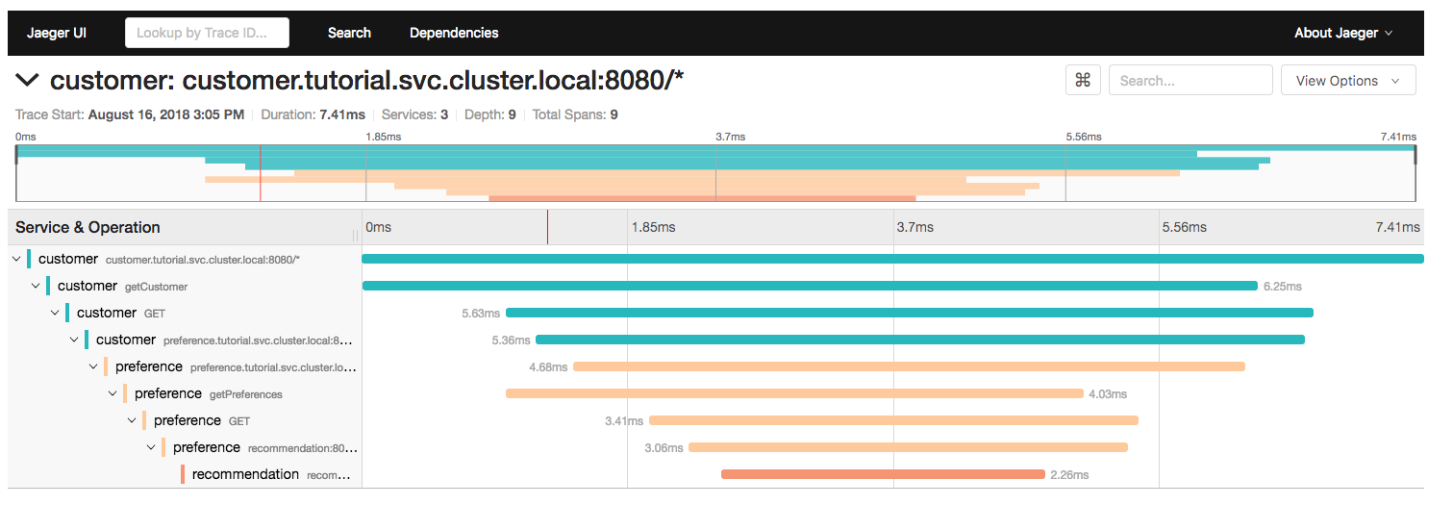

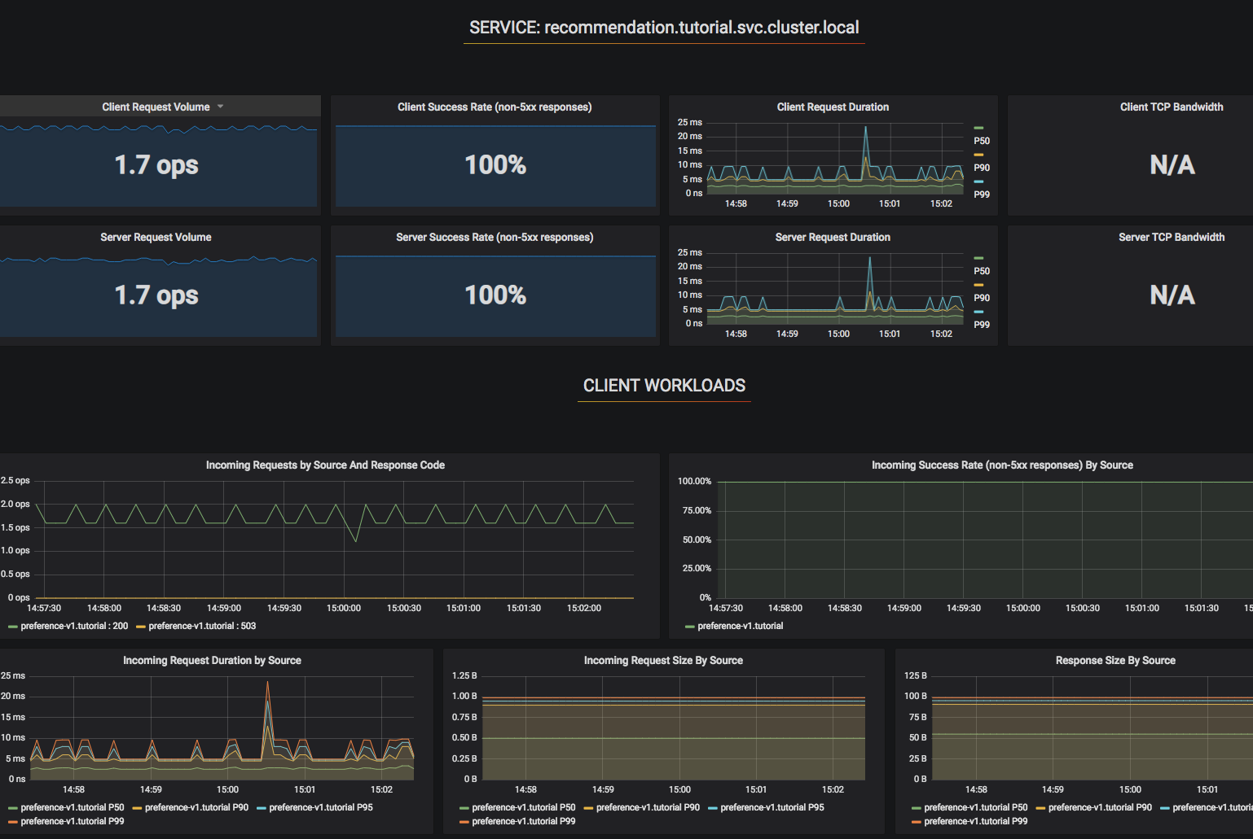
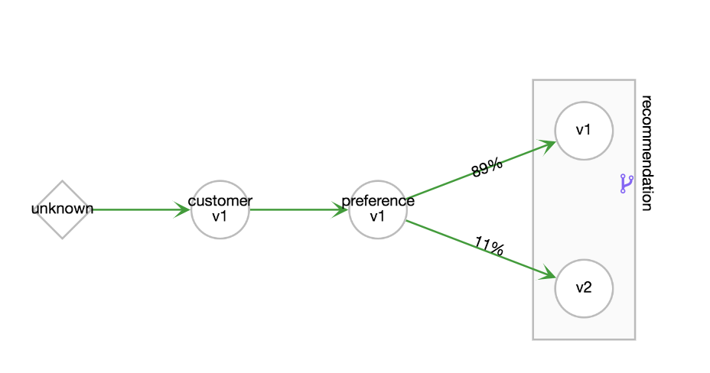
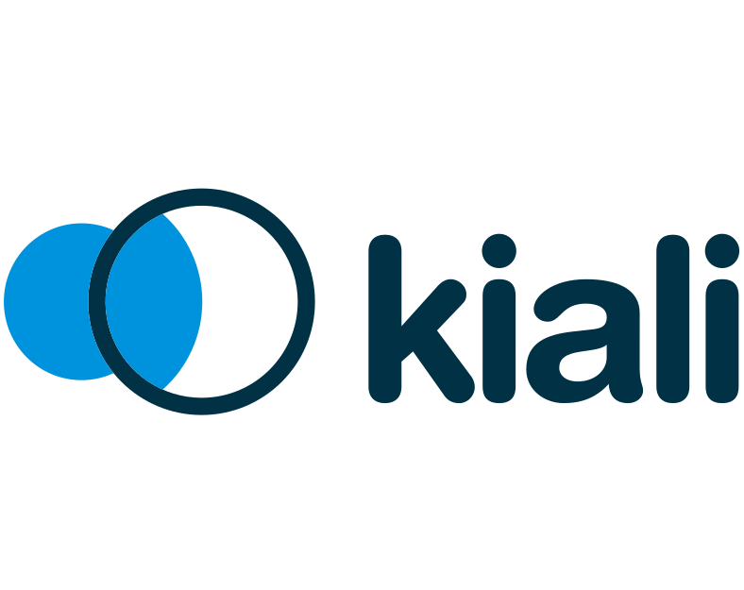

RED HAT SERVICE MESH
Applies security, route rules, policies and reports traffic telemetry at the pod level
Secure
Istio
Jaeger
Prometheus
Observe
Observe
Connect
Control
Kiali
Grafana
Generally Available in July

Slide 34
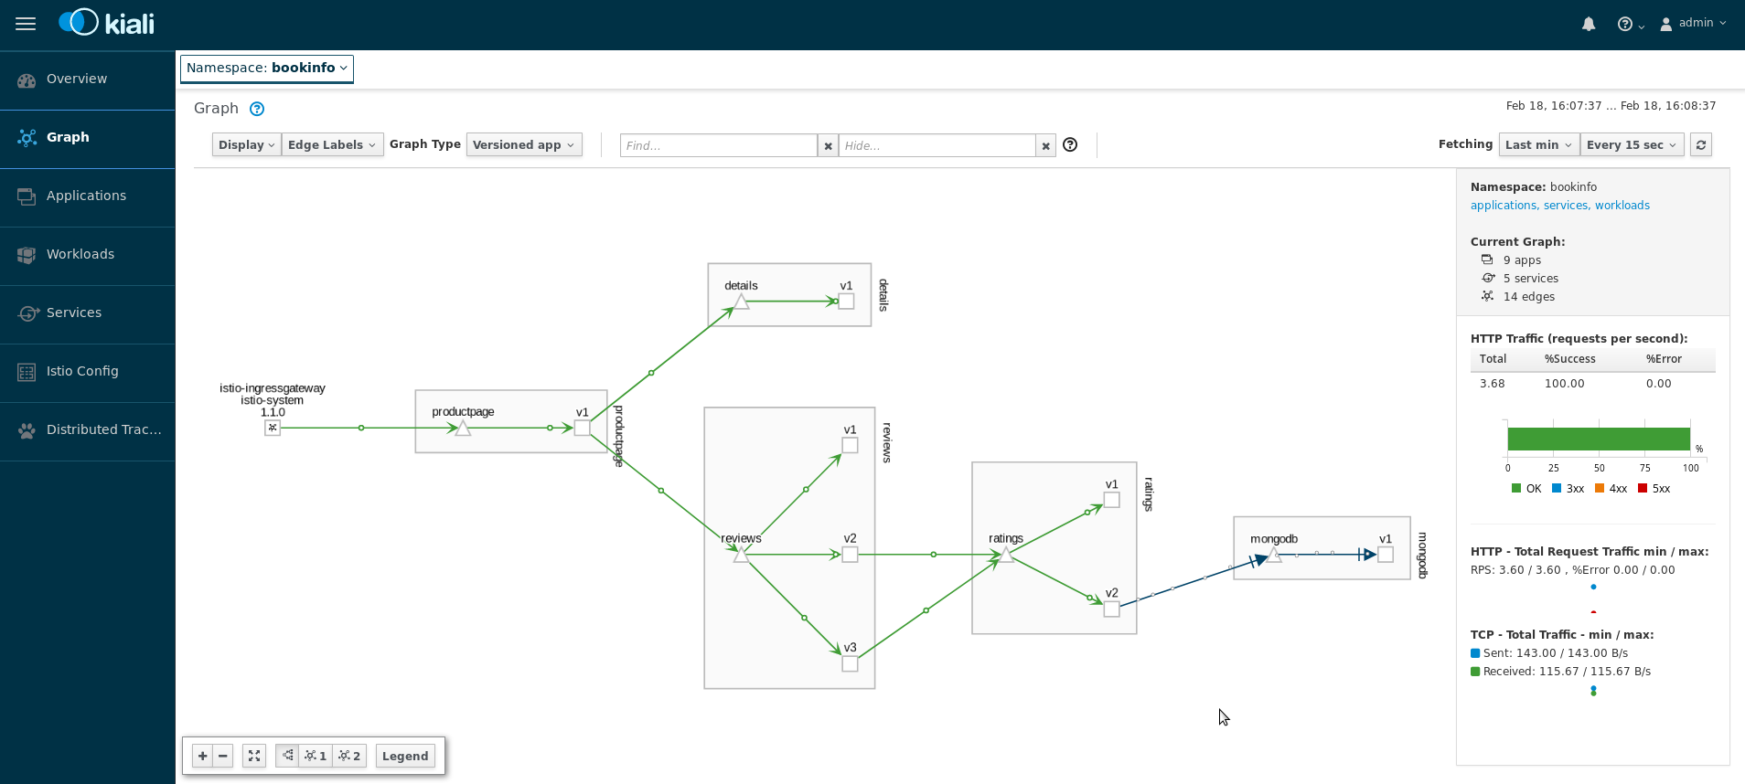
OBSERVABILITY WITH KIALI
Notes:
Kiali was created by our middleware team with the explicit goal of improving the visualization and management of Istio. It provides a mechanism of viewing telemetry about an application running within the service mesh, the topology of applications, and even graphs of traffic flows.

Slide 35


SECRETS MANAGEMENT
Secure mechanism for holding sensitive data e.g.
Passwords and credentials
SSH Keys
Certificates
Secrets are made available as
Environment variables
Volume mounts
Interaction with external systems (e.g. vaults)
Encrypted in transit and at rest*
Never rest on the nodes
MASTER
Distributed Store
NODE
Container
Container
* Full disk encryption is supported for AWS, VSphere. Encrypting the etcd datastore is not available in OCP 4.1. Targeted for OCP 4.3.
Notes:
https://docs.openshift.com/container-platform/4.1/nodes/pods/nodes-pods-secrets.html
In 3.11, secrets stored in etcd can be encrypted at rest; this is not supported in 4.1 due to archictectural changes. We are working to add back support in 4.2 or 4.3.
Having an easy-to-use, secure-by-default secret distribution mechanism is exactly what developers and ops need to solve the secrets management problem once and for all
Because secret objects can be created independently of the pods that use them, there is less risk of the secret being exposed during the workflow of creating, viewing, and editing pods.
A secret is only sent to a node if a pod on that node requires it. It is not written to disk. It is stored in a temporary file-storage facilities (tmpfs). It is deleted once the pod that depends on it is deleted.
3.x only: Secrets are stored as plaintext in etcd however the etcd storage can be encrypted to remove the security risk. The decryption key is stored in a config file on disk.
Customers can also choose to use an external vault and key management system if they prefer.
WIP for 4.x; in 4.0, we will encrypt AWS volumes to protect secrets at rest in etc; discussing supporting KMS. (Feedback on acceptability of volume encryption appreciated.)
Roadmap: Add back support for encrypting secrets stored in etcd and support Kube KMS for key management

Slide 36
CERTIFICATE MANAGEMENT
Certificates are used to provide secure connections to
master and nodes
Ingress controller and registry
etcd
Certificate rotation is automated
Optionally configure external endpoints to use custom certificates
For example: Requesting and Installing Let’s Encrypt Certificates for OpenShift 4
✓
MASTER
✓
ETCD
✓
NODES
✓
INGRESS CONTROLLER
✓
CONSOLE
✓
REGISTRY
Notes:
Certificates are used to provide secure connections to master and nodes, Ingress controller and registry, etcd. Certificate rotation is automated. Optionally configure external endpoints to use custom certificates.
You cannot replace the Root CA of an OCP 4 cluster. Target for enhancements here is 4.3 or 4.4.
https://docs.openshift.com/container-platform/4.1/networking/ingress-operator.html#nw-ingress-setting-a-custom-default-certificate_configuring-ingress
https://docs.openshift.com/container-platform/4.1/networking/routes/secured-routes.html
Web Console is accessed via the ingress controller
https://docs.openshift.com/container-platform/4.1/authentication/certificates/api-server.html
https://docs.openshift.com/container-platform/4.1/registry/configuring-registry-operator.html
https://blog.openshift.com/requesting-and-installing-lets-encrypt-certificates-for-openshift-4/
For Application cert management, see:
https://blog.openshift.com/self-serviced-end-to-end-encryption-approaches-for-applications-deployed-in-openshift/
https://blog.openshift.com/self-serviced-end-to-end-encryption-for-kubernetes-applications-part-2-a-practical-example/

Slide 37
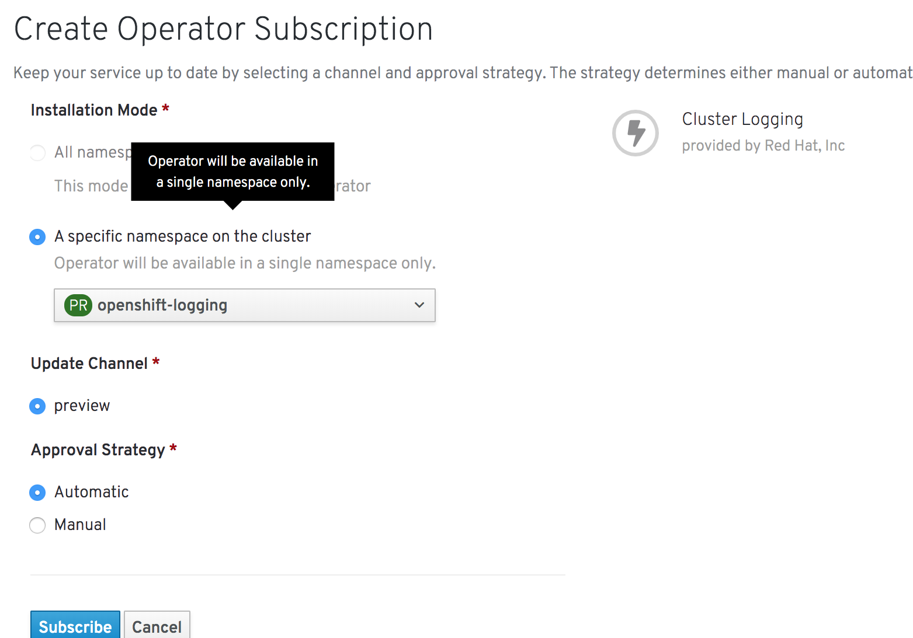
CLUSTER LOG MANAGEMENT
Install the Elasticsearch and Cluster Logging Operators from OperatorHub
EFK stack aggregates logs for hosts and applications
Elasticsearch: a search and analytics engine to store logs
Fluentd: gathers logs and sends to Elasticsearch.
Kibana: A web UI for Elasticsearch.
Access control
Cluster administrators can view all logs
Users can only view logs for their projects
Central Audit policy configuration
Ability to send logs elsewhere
External elasticsearch, Splunk, etc
# configure via CRD
apiVersion: "logging.openshift.io/v1"
kind: "ClusterLogging"
metadata:
name: "instance"
namespace: "openshift-logging"
spec:
managementState: "Managed"
logStore:
type: "elasticsearch"
elasticsearch:
nodeCount: 3
resources:
limits:
cpu: 800m
memory: 1Gi
requests:
cpu: 800m
memory: 1Gi
storage:
storageClassName: gp2
size: 100G
redundancyPolicy: "SingleRedundancy"
visualization:
type: "kibana"
kibana:
replicas: 1
curation:
type: "curator"
curator:
schedule: "30 3 * * *"
collection:
logs:
type: "fluentd"
fluentd: {}
Notes:
https://docs.openshift.com/container-platform/4.1/logging/config/efk-logging-external.html
If you use the OCP 4 logging stack, you must put the operator into the unmanaged state to forward logs to a SIEM. In Unmanaged state, the operators do not respond to changes in the CRs. The administrator assumes full control of individual component configurations and upgrades when in unmanaged state. Roadmap: log pipelines targeted for 4.3 or 4.4.

Slide 38
ATTACHED STORAGE
Secure storage by using
SELinux access controls
Secure mounts
Supplemental group IDs for shared storage
RHEL CoreOS
RHEL CoreOS
RHEL CoreOS
RHEL CoreOS
RHEL CoreOS
RHEL CoreOS
RHEL CoreOS
Notes:
Securing your attached storage is also important. OpenShift provides plug-ins for multiple flavors of storage, including NFS, AWS Elastic Block Stores (EBS), GCE Persistent Disks, GlusterFS, iSCSI, RADOS (Ceph) and Cinder.
A PersistentVolume can be mounted on a host in any way supported by the resource provider, such as ReadWriteOnce, ReadOnlyMany and ReadWriteMany.
For Block Storage (EBS, GCE Persistent Disks, iSCSI, etc.) OpenShift uses SELinux capabilities to secure the root of the mounted volume, making the mounted volume owned by and only visible to the container it’s associated with.
Access to Shared Storage (NFS, Ceph, Gluster, etc.) can be managed by adding the group id (gid) of the PV to the supplemental groups of the pod, giving that pod access to the contents of the shared storage.
Data in transit is encrypted via https for all OpenShift components communicating between each other.
Additional details on all options are available in the OpenShift documentation.

Slide 39




APPLICATION API MANAGEMENT
Container platform & application APIs
Authentication and authorization
LDAP integration
End-point access controls
Rate limiting
Notes:
You also need to plan to secure the external APIs that provide access to your applications. Micro-services applications, especially, have multiple independent API services. We recommend using an API management tool such as 3scale API gateway for enhanced API security. 3scale gives you a variety of standard options for API authentication and security, which can be used alone or in combination to issue credentials and control access.
3scale’s access control features go beyond basic security and authentication. Application and account plans let you restrict access to specific endpoints, methods, and services and apply access policy for groups of users.
Application plans allow you to set rate limits for API usage and control traffic flow for groups of developers. Set per-period limits for incoming API calls to protect your infrastructure and keep traffic flowing smoothly. Automatically trigger overage alerts for applications that reach or exceed rate limits, and define behavior for over-limit applications.

Slide 40
EXTEND SECURITY

Slide 41

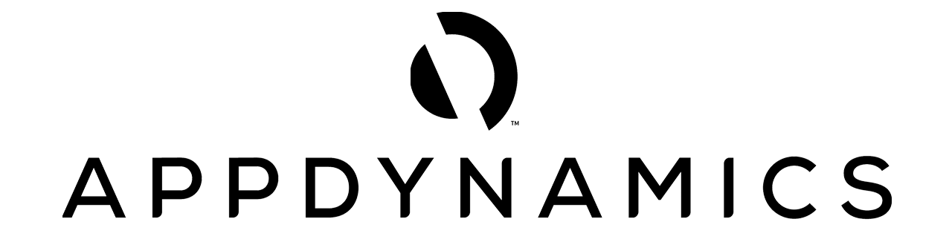
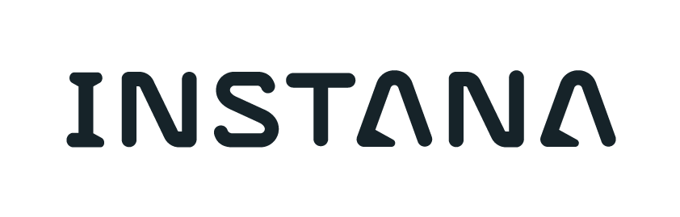


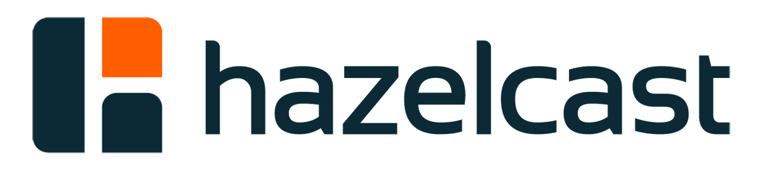
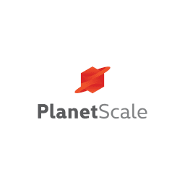


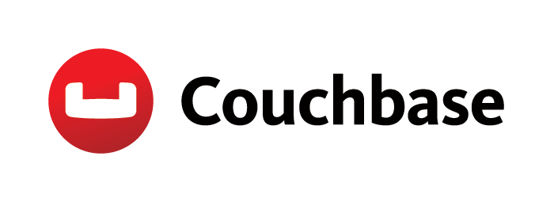










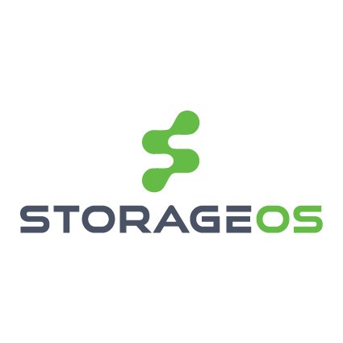
RED HAT CERTIFIED OPERATORS
DEVOPS
APM
DATA SERVICES
DATABASE
SECURITY
STORAGE

Slide 42











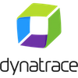



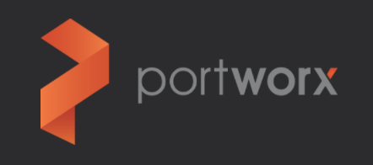








THE BROAD SECURITY ECOSYSTEM
Notes:
And, let’s not forget about the ecosystem.
OpenShift has partners in all of these areas, including:
Identity and Access management / Privileged Access Management: Tremolo Security & CyberArk
Registry / Repository manage partners: JFrog Artifactory, Sonatype Nexus, Quay (now Red Hat)
CI/CD: Jenkins
Container content scanners & vulnerability management tools: AquaSecurity, Black Duck, JFrog X-Ray, SysDig, Twistlock
External Certificate Authorities: RH consulting has helped implement custom solutions for customers; features on on the roadmap to make these integrations easier.
External Vaults / Key Management solutions: RH consulting has helped implement custom solutions for customers with solutions like Hashicorp Vault, CyberArk; features on on the roadmap to make these integrations easier.
Transparent encryption with e-Thales Vormetric
Application security:
Web protection: Signal Sciences, F5
Container runtime analysis tools: AquaSecurity, Twistlock
Application and cluster health: CoScale, Dynatrace, Sysdig
Security Information and Event Monitoring (SIEM): RH consulting has helped implement custom integrations for customers with tools like Splunk
For those of you particularly interested in network security, you may want to consider our network partners:
Network partners: Juniper Networks Contrail (SDN), Cisco Contiv, Nuage Networks (SDN) & NeuVector (network security container)

Slide 43
ROADMAP

Slide 44
SECURITY FEATURE ROADMAP DEFENSE IN DEPTH - Control, Defend, Extend
Linux Host Security
RHCOS FIPS mode RHCOS Auditd
Authentication & Authorization
Integration with external Keycloak
Use group membership from external IPs
Secrets & Certificates
Improved cert management and Integration with external CAs via ACME
Integration with external Key Management Systems
Integrated Audit & Logging
East / West traffic tracing with OpenShift Service Mesh (GA summer 2019)
Network Policies
Control service access flow with OpenShift Service Mesh (GA summer 2019)
Networking Isolation
East / West mutual TLS authentication with OpenShift Service Mesh (GA summer 2019)
Image Security
Clair v3 covers more content
Trusted Container Content
CI/CD Pipeline
Quay Registry with Image Scanning
ImageStreams
Built-In IAM
Deployment Policies (SCCs)
Secrets Management
Network Policy & Isolation
Audit & Logging
API Management
Container Host Multi-tenancy / Container Optimized Immutable OS
Security Ecosystem
Notes:
Our approach to security in OpenShift is to provide Defense in Depth by delivering security capabilities throughout the OpenShift stack: the host OS, the OpenShift platform itself, and the CI/CD pipeline.
OpenShift leverages the security capabilities of RHEL today and host and application container security is enhanced in 4.0 and beyond with the OpenShift control plane running exclusively on our container optimized, minimal OS, Red Hat Core OS. RHCOS updates are managed and delivered as part of the OpenShift platform. Support for disconnected install and upgrades is planned.
We’ll talk about investments in Identity and Access Management (IAM), as well as certificate and secrets management on the next slide.
OpenShift Service Mesh adds a number of new features to our Defense in Depth story, in particular mutual TLS authentication and traceability of east/west network traffic. It also adds new ways of defining policies for communication between application services running on the cluster as well.
A major addition to OpenShift 4.0, Multus support makes it possible for customers to isolate the OpenShift control plane and data plane -- a frequent request from our most security-conscious customers.
Finally, we are investing in Clair, our container vulnerability scanner, which is included with Quay. We are adding support for additional packages, as mentioned earlier.

Slide 45
OPENSHIFT NETWORK PLUGINS
OPENSHIFT
KUBERNETES CNI
Flannel1
Nuage
Tigera
Calico & CNX
Juniper
Contrail
Cisco
Contiv & Contiv-ACI
Big Switch
VMware
NSX-T
kuryr-
kubernetes
Open Daylight
DEFAULT
(CNI & Kuryr)
openshift-sdn
OVN²
RH-OSP
Neutron
Validated Operator
In-Progress
PLUGIN
¹ Flannel is minimally verified and is supported only and exactly as deployed in the OpenShift on OpenStack reference architecture
² Targeting OCP 4.2 GA
Notes:
The upstream COE Project for OpenDaylight is developing both a CNI plug-in and Kuryr integration for OpenShift.

Slide 46
RISK MANAGEMENT AND COMPLIANCE GOALS
Automate compliance audit and remediation
Coverage for Risk Management Frameworks
A Compliance Assessment Process
Platform and SecOps Integration
Achieving and Maintaining regulatory compliance

Slide 47
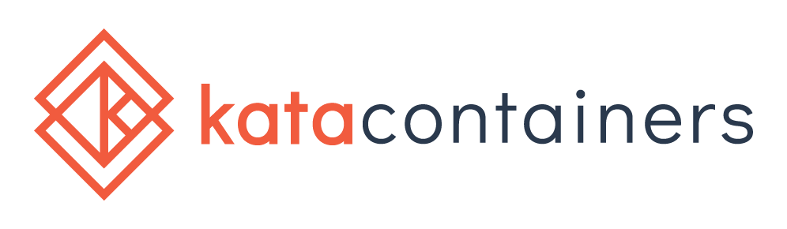
VIRT-BASED CONTAINERS
What is the future for KVM isolated containers?
Lots of interest from customers in this area
All of these solutions have limitations, compatibility issues, and are not mature enough to support
Customers seem to get less excited as they learn about the gaps
Not mature enough to be on our product roadmaps
Kata seems to be the most promising solution and community
We are engaged upstream and currently bringing kata into Fedora
gVisor

Slide 48
Thank you
Red Hat is the world’s leading provider of enterprise open source software solutions. Award-winning support, training, and consulting services make Red Hat a trusted adviser to the Fortune 500.

Slide 49
Appendix:
Security challenges and priorities

Slide 50
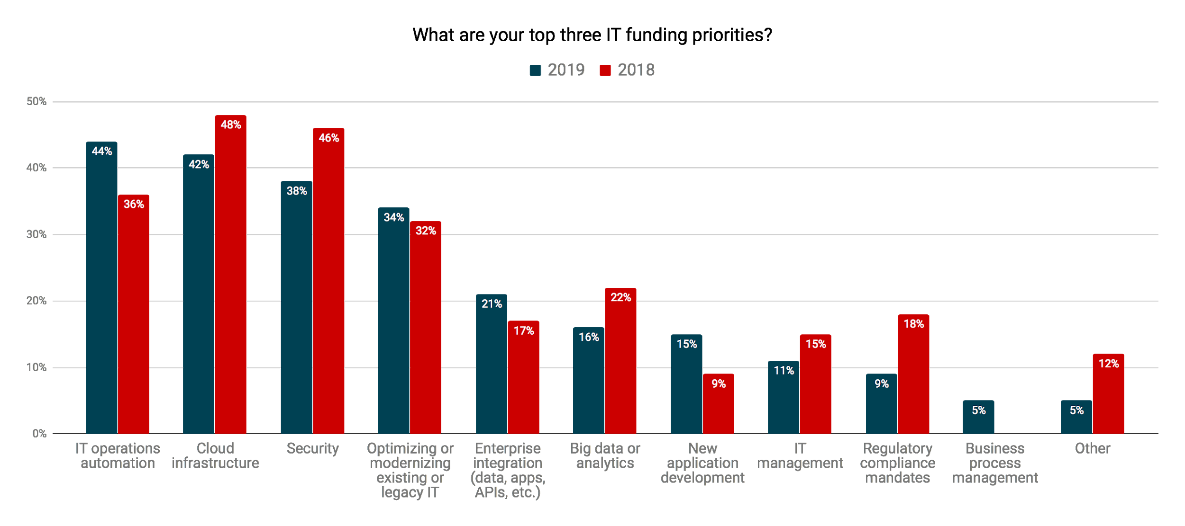
Top Funding Priorities for 2019:
Automation, Cloud, & Security
Source: Global IT Trends & Priorities Research, November 2018, Qualtrics and Red Hat
Notes:
In that same survey, Automation, cloud, and security are top IT funding priorities for second year in a row
The top IT funding priorities for organizations in 2019 are IT operations automation, cloud infrastructure, and security, in that order. This same trio of priorities hit the top 3 last year; however, automation moved from third to first this year, with 44% of respondents saying it was a top 3 funding priority compared to 36% last year, indicating an increased emphasis in taking out manual operations across IT in order to increase productivity and reduce costs. This matches up with the demand and excitement we see in the market for Red Hat Ansible, our automation product family. While cloud and security dipped slightly percentage-wise from the 2018 numbers, they outranked most other priorities by a significant margin.

Slide 51
The Cyber Security Challenge is not Getting Easier
65%
57%
29%
5%
Reported increased
Severity of attacks
Said the time to resolve
an incident has grown
Have their ideal security-
skilled staffing level,
making it the #2 barrier to
Cyber resilience
Portio of alerts coming in
that the average security
team examines every day
¹ The Third Annual Study on the Cyber Resilient Organization - Ponemon Institute, 2018 (Sponsored by IBM)
² https://venturebeat.com/2017/12/16/the-lesson-behind-2017s-biggest-enterprise-security-story/
Notes:
Whether proprietary or open source, security cannot be taken for granted, and this is where vendors must partner closely with their customers to maintain a security posture that spans the entire digital transformation architecture and journey. This is only going to become more important (and more difficult) as the amount of data and the sophistication of hackers and cybercriminals continues to increase.

Slide 52
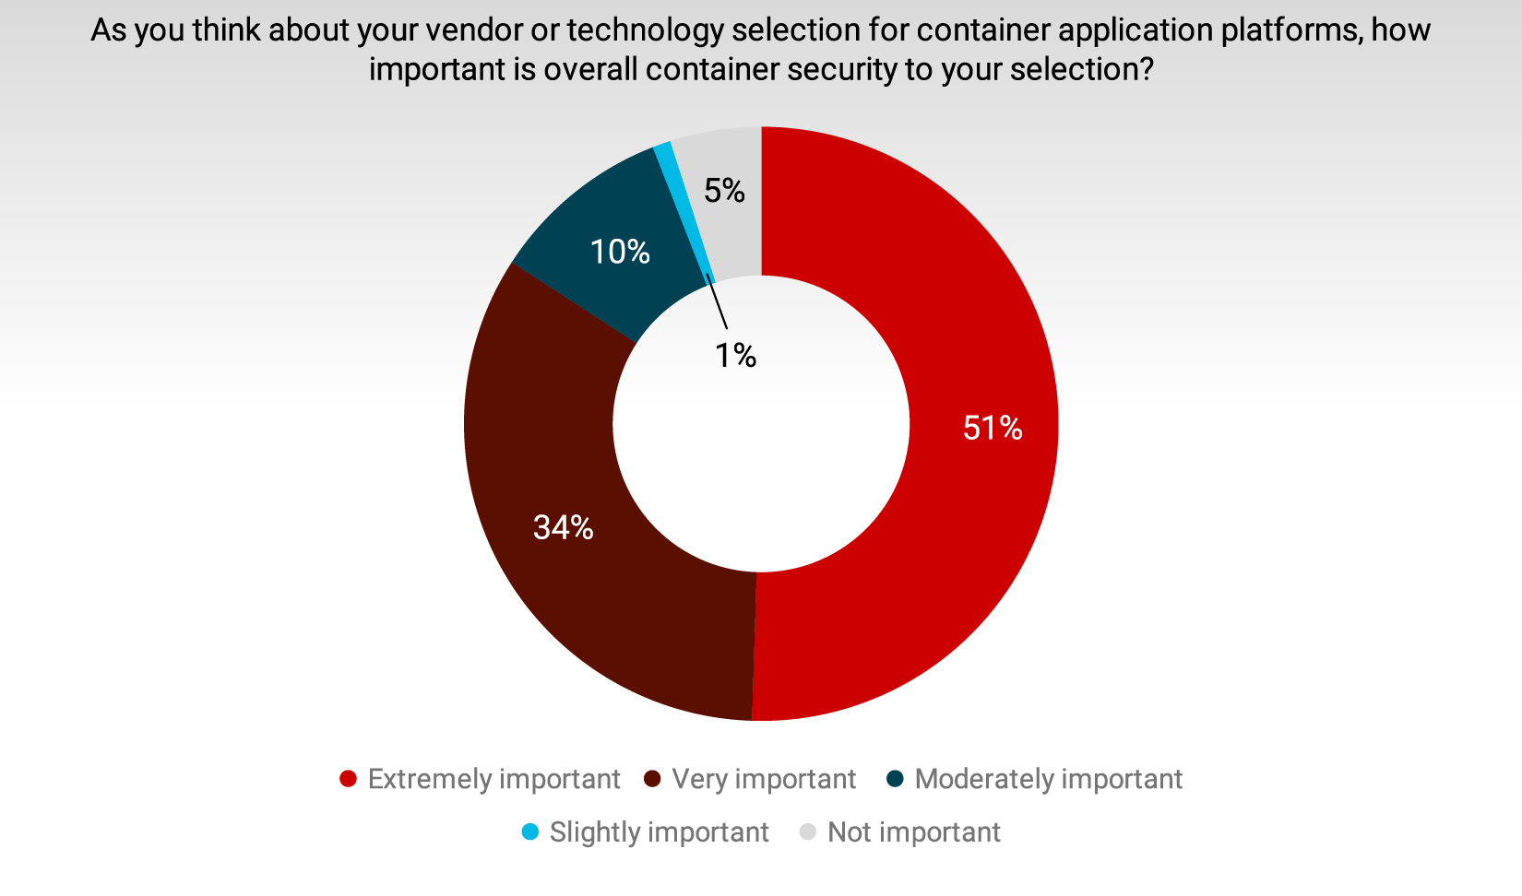
Choosing a Container Platform Vendor?
Security is Critical
Source: Global IT Trends & Priorities Research, November 2018, Qualtrics and Red Hat
Notes:
Basically, IT leaders want vendors to be good at security.
With all the security issues and data breaches in the news this past year, we added some questions around how IT leaders think about security when it comes to vendor selection and partnership. We know from this and other research that security will always come up as a top priority, challenge, investment requirement, etc. Security is an important consideration when choosing container platform vendors. 85% of respondents consider container security extremely important or very important when choosing a vendor.’

Slide 53
Appendix:
Storage

Slide 54

Just like money, containers need safe and reliable storage and transmission
Notes:
Think of containers as money and registries as banks. Just like it would be unthinkable for an enterprise to not use a bank to store and manage its funds, so to is it unthinkable for an enterprise to not keep its images in a registry. In both instances the organization needs a secure, centralized location that is automation friendly to increase the speed, security, and accuracy of its operations.
Creative commons image from: https://unsplash.com/photos/pElSkGRA2NU

Slide 55
Appendix:
Red Hat Quay

Slide 56
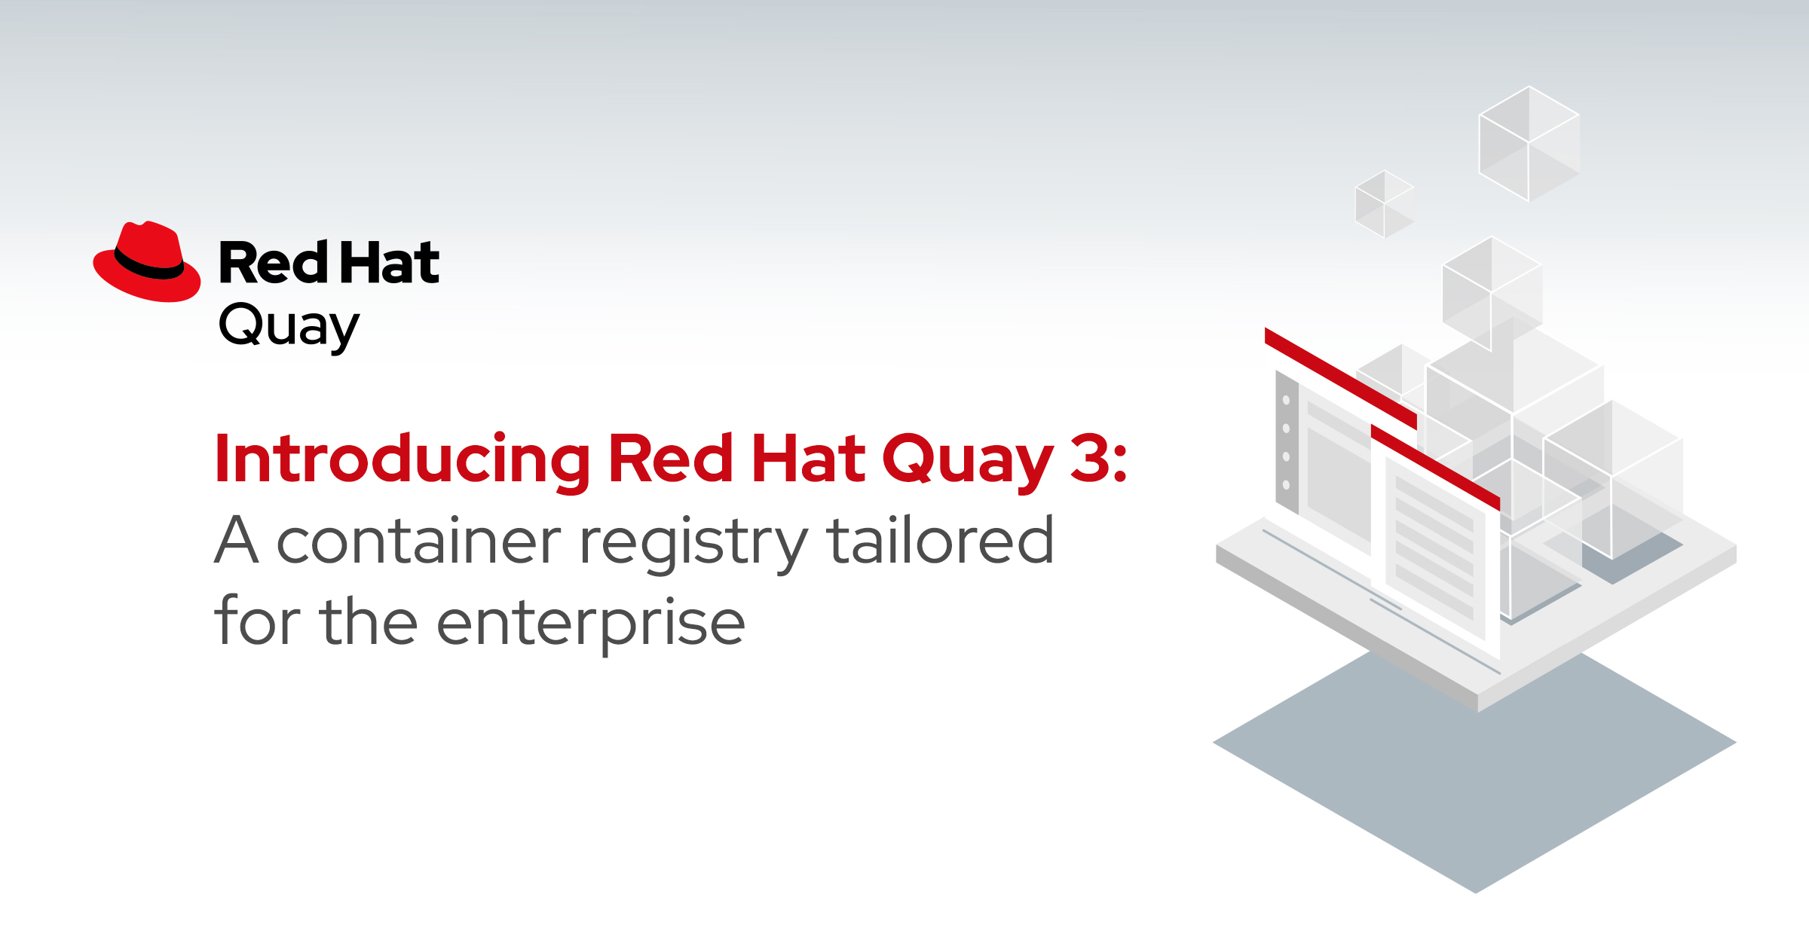
RED HAT QUAY V3
Quay v3 Key Features
Full support for Docker Registry API v2_s2
Multi-arch (manifest) and Windows images
Rebranded and rebased (RHEL)
New config UI to save & upload Quay config
Parallel upgrade (2x 5min downtime only)
Red Hat Quay and OpenShift
Red Hat Quay and OpenShift work well together. This includes both running Quay on and using Quay with OpenShift.
Introducing Red Hat Quay 3
Notes:
What’s new in v3 field enablement: https://bit.ly/2VLjYUU
On the Quay side we released the first RH branded Quay version at the week before Summit. It primarily introduces multi-arch support which also includes support for MS Windows images. We also rebased all 3 Quay images onto RHEL and added a new config UI which allows customers to save and upload a quay configuration and to automatically deploy quay configuration changes via green-blue deployments if quay runs on kubernetes or openshift. The upgrade to v3 is documented and only requires two short downtimes to change one line of the configuration file.
In addition to the features we introduced a couple of surrounding items such as a new lifecycle and support policy, a customer self-service eval form and a small but import pricing change for HA setups. There is also a ton of new customer facing and field enablement collateral including a new roadmap deck and recording, competitive training, an extended sales FAQ and a new technical FAQ, a sales overview and sales deep dive training and so on. All of those can be found in the new Quay mojo group shown here and OneStop as well. I also did an initial field enablement for APAC last week summarizing all those changes which is linked from the internal announcement blog where the link is shown here as well.
It's worth to mention that although Quay is a standalone product it can be used with OpenShift already today, with or without using the openshift internal registry. The existing documentation on how to run Quay ON openshift is currently under review and we will improve and extend it pretty soon. We're also working with our field teams on an entirely new documentation on how to use quay WITH openshift to close a well-known and important documentation gap asked by many customers and RH internal folks. More to come soon, so stay tuned.

Slide 57

REGISTRY FEATURES
Vulnerability Scanning (powered by Clair) Continually scan your containers for vulnerabilities, giving you complete visibility into known issues and how to fix them
Geographic Replication Reliably store, build and deploy a single set of container images across multiple geographies
Automated software deployments Streamline your continuous integration/continuous delivery (CI/CD) pipeline with build triggers, git hooks, and robot accounts
Advanced Access Control Management Fine-grain access control of the registry with multiple identity and authentication providers as well as support for teams and organization mapping
Quay.io
Hosted Container Registry
Red Hat Quay
Private Container Registry
SUPPORT & MAINTENANCE
Notes:
What’s new in v3 field enablement: https://bit.ly/2VLjYUU
On the Quay side we released the first RH branded Quay version at the week before Summit. It primarily introduces multi-arch support which also includes support for MS Windows images. We also rebased all 3 Quay images onto RHEL and added a new config UI which allows customers to save and upload a quay configuration and to automatically deploy quay configuration changes via green-blue deployments if quay runs on kubernetes or openshift. The upgrade to v3 is documented and only requires two short downtimes to change one line of the configuration file.
In addition to the features we introduced a couple of surrounding items such as a new lifecycle and support policy, a customer self-service eval form and a small but import pricing change for HA setups. There is also a ton of new customer facing and field enablement collateral including a new roadmap deck and recording, competitive training, an extended sales FAQ and a new technical FAQ, a sales overview and sales deep dive training and so on. All of those can be found in the new Quay mojo group shown here and OneStop as well. I also did an initial field enablement for APAC last week summarizing all those changes which is linked from the internal announcement blog where the link is shown here as well.
It's worth to mention that although Quay is a standalone product it can be used with OpenShift already today, with or without using the openshift internal registry. The existing documentation on how to run Quay ON openshift is currently under review and we will improve and extend it pretty soon. We're also working with our field teams on an entirely new documentation on how to use quay WITH openshift to close a well-known and important documentation gap asked by many customers and RH internal folks. More to come soon, so stay tuned.

Slide 58
VULNERABILITY SCANNING - CLAIR
Quay integrates with Clair to continually scan your containers for vulnerabilities.
You get complete visibility into known issues and how to fix them.
Notes:
What’s new in v3 field enablement: https://bit.ly/2VLjYUU
On the Quay side we released the first RH branded Quay version at the week before Summit. It primarily introduces multi-arch support which also includes support for MS Windows images. We also rebased all 3 Quay images onto RHEL and added a new config UI which allows customers to save and upload a quay configuration and to automatically deploy quay configuration changes via green-blue deployments if quay runs on kubernetes or openshift. The upgrade to v3 is documented and only requires two short downtimes to change one line of the configuration file.
In addition to the features we introduced a couple of surrounding items such as a new lifecycle and support policy, a customer self-service eval form and a small but import pricing change for HA setups. There is also a ton of new customer facing and field enablement collateral including a new roadmap deck and recording, competitive training, an extended sales FAQ and a new technical FAQ, a sales overview and sales deep dive training and so on. All of those can be found in the new Quay mojo group shown here and OneStop as well. I also did an initial field enablement for APAC last week summarizing all those changes which is linked from the internal announcement blog where the link is shown here as well.
It's worth to mention that although Quay is a standalone product it can be used with OpenShift already today, with or without using the openshift internal registry. The existing documentation on how to run Quay ON openshift is currently under review and we will improve and extend it pretty soon. We're also working with our field teams on an entirely new documentation on how to use quay WITH openshift to close a well-known and important documentation gap asked by many customers and RH internal folks. More to come soon, so stay tuned.

Slide 59
Appendix:
Next generation container tools

Slide 60






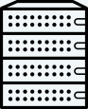
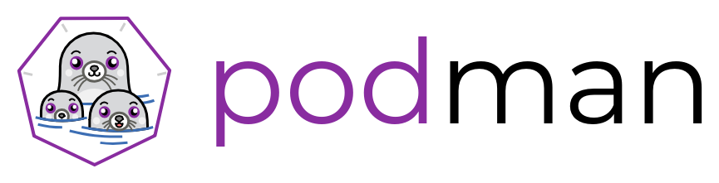
NEXT-GEN CONTAINER TOOLS
Providing stability, flexibility and performance with containers and images
Container-tools - OCI tooling to create, run, and manage, Linux Containers with an enterprise life cycle.
Conform to the OCI image and runtime specifications
Daemon-less, OS-native container tooling
Separation of concerns
Build OCI/docker Images
skopeo
Inspect, copy, & sign Images
RHEL
run, manage, debug containers
Notes:
Multi-stage builds are a new feature requiring Docker 17.05, therefore no one can leverage the Dockerfile format with docker on the nodes
Buildah:
An OCI-compliant, daemon-less tool for building and modifying OCI / Docker images.
Enables fine-grain control over the commands and content of each image layer
Utilities from the container host can optionally be leveraged as part of the build
Build instructions can be passed as a Dockerfile
Shares the underlying image and storage components with CRI-O
Roadmap :
User namespace enablement
Working towards unprivileged, non-root container builds
Future integrations with OpenShift (image-builder)

Slide 61
Appendix:
Network security

Slide 62
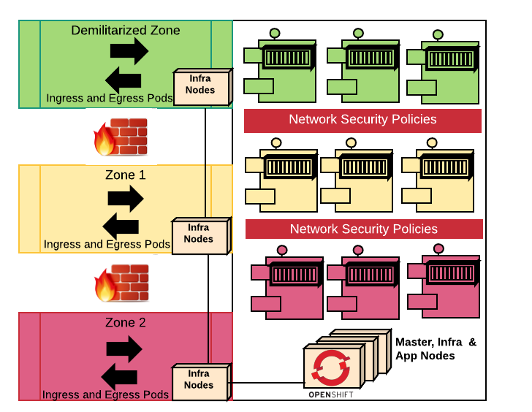
OPENSHIFT CLUSTER COVERING MULTIPLE ZONES
Application pods run on one OpenShift Cluster.
Microsegmented with Network Security policies.
Infra Nodes in each zone run Ingress and Egress pods for specific zones.
If required, physical isolation of pods to specific nodes is possible with node-selectors. But that can reduce worker node density.
Notes:
This model may not securely handle the use of OpenShift deployed in the DMZ since every OpenShift cluster has endpoints that should be considered internal only and not be exposed to the Internet. Endpoints such as the master API, Logging, Metrics, registry, should be internal-only. As such, when installing OpenShift in a DMZ, additional actions are necessary to protect those endpoints.

Slide 63
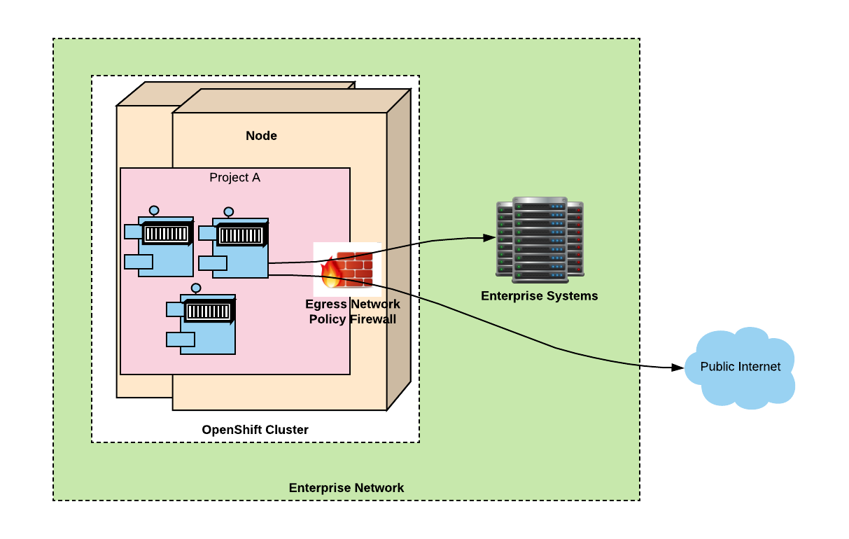
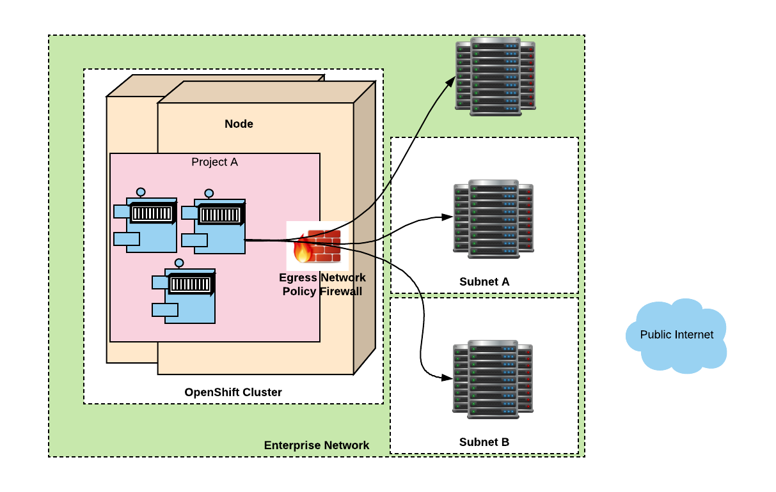


EGRESS FIREWALL TO LIMIT ACCESS
Cluster admin can limit the external addresses accessed by some or all pods from within the cluster
Examples:
A pod can talk to hosts (outside OpenShift cluster) but cannot connect to public internet
A pod can talk to public internet, but cannot connect to hosts (outside OpenShift cluster)
A pod cannot reach specific subnets/hosts
Notes:
A pod cannot reach specific subnets/hosts

Slide 64
BUILDING UPON MULTUS
Development is now unblocked for a number of customer use cases
Functional separation of control/data planes
Default SDN on primary interface for management traffic
Data-plane traffic on secondary (or tertiary…) interface
Link aggregation for network redundancy
Different network protocol stacks, capabilities, SLAs
Network traffic isolation, segregation and security
User-space networking (e.g. VPP, OVS-DPDK)
VLAN, MACVLAN, host device networking
Video Streaming (Multicast)
High Performance Networking - e.g. SR-IOV
Openshift-SDN/OVN-Kubernetes as primary interface for management traffic
SR-IOV Device Plugin for VF hardware resource scheduling
SR-IOV CNI plugs VFs assigned by device plugin into pods as data plane interfaces
QoS
CNV (kubevirt) Networking
SDN Migration (e.g. our next-gen SDN)
Notes:
Kubernetes only recognizes the first interface, which it uses for the cluster management network traffic. Additional interfaces can be used to define entirely separate networks to be used for data plane traffic.
A second and third interface can be tied to their own NICs, each of which might be attached to a TORS, and traffic aggregated at the host level.
Completely different networking can be used on the different interfaces for their specific capabilities.
Traffic can be isolated by defining subnets not on the default network.
High-performance networking, e.g. SR-IOV which connects pod memory to that of a NIC, provides line-rate performance, but is “hard wired” to a particular physical NIC.
User-space networking like ovs-dpdk and VPP, are software defined high-performance solutions that work with generic or unknown NICs.
QoS tags can be assigned to different interfaces, and priorities assigned.
CNV requires the vlan CNI plugin, for live migrating VMs.
We’ve successfully tested simple migrations from one SDN to another by pluggin each CNI into a different interface, creating a route between the two, and migrating pods from the original SDN coniguration to the new one. We hope to take advantage of this for our future OVN migration story.

Slide 65
Appendix:
Pod Security Policies

Slide 66
SECURITY CONTEXT CONSTRAINTS &
POD SECURITY POLICIES
Security Context Constraints (SCCs) allow administrators to control permissions for pods. SCCs define a set of conditions that a pod must run with in order to be accepted into the system. Red Hat has contributed this feature to Kubernetes as Pod Security Policies (PSPs).
PSPs are not yet as mature as SCCs. We will enable customers to migrate from SCCs to PSPs as soon as we have feature parity. We are also working to ensure that SCCs support new settings available with PSPs. Additional information on these new settings is available in Kubernetes documentation.
Notes:
For more information see
https://docs.google.com/document/d/1Jx7T8B9eYuT-QTGwljNkDL58R6o1o2H0ok2wjZM7P_Q/edit?usp=sharing

Slide 67
Appendix:
Cluster migration

Slide 68

CLUSTER MIGRATION OPENSHIFT 3 to 4
vSphere OpenShift 3.10 Cluster
Target PVs using NFS
AWS OpenShift 4.1 Cluster
S3 Bucket
$ oc command
Full Backup
Increment Diff Backup
(like rsync)
$ oc command
New EBS PV based on restic restore and mount to migrated app
Deploy a replication of your applications from one OpenShift cluster to a different OpenShift cluster
Enable cluster specific configuration from OpenShift 3 to work on a OpenShift 4 cluster
Documentation on how to handle common network, storage, and machine/node re-use scenarios between OpenShift 3 and OpenShift 4 clusters
Notes:
To help existing customer get to OpenShift 4, we are building automated cluster migration tools which will migrate a customer’s projects, application services, cluster configuration and associated artifacts to 4.0.
We originally explored and inplace upgrade, but decided against it for 2 reasons.
First, an inplace upgrade from OpenShift 3 to 4 would be complex and error prone, given how much we have changed in how both OpenShift Kubernetes and the underlying OS is provisioned and configured.
Second, since Kubernetes can only be upgraded sequentially version to version, an inplace upgrade would only help the subset of customers who are already on 3.11. However, the majority of customers are still on earlier versions

